Slide 1
Using the GPA Calculators in Degree Works

Slide 2
GPA Calc
The GPA Calculators can help you plan and provide advice on how to maintain and/or achieve a specific GPA. This is helpful if you are required to obtain a certain GPA for transfers, honors, scholarships, financial aid or other reasons. Note: GPA calculators can give you an estimation only and will not change your GPA.
There are three types of calculators available in the GPA tab.
Graduation Calculator: Lets you plan ahead and set academic goals to achieve your desired GPA upon Graduation.
Term Calculator: Lets you see how your predicted grades for currently enrolled courses will affect your cumulative GPA at the end of the term.
Advice Calculator: Lets you see possible paths to obtain your desired GPA and achieve academic goals.

Slide 3
Graduation Calculator
Use the Graduation calculator to estimate if you can achieve your desired GPA for graduation in relation to outstanding credits remaining and credits required to attain your degree.
Click and select Graduation Calculator. Note: Your current GPA is automatically entered.
Enter Credits Remaining and Credits Required to complete your degree.
Enter the GPA you would like to earn upon graduation.
Click Calculate at bottom of screen or Recalculate to get another estimate.
The results will display the average and number of credits you need to achieve your desired GPA. Note the Disclaimer that GPA Calculators are unofficial and are for estimation only.

Slide 4
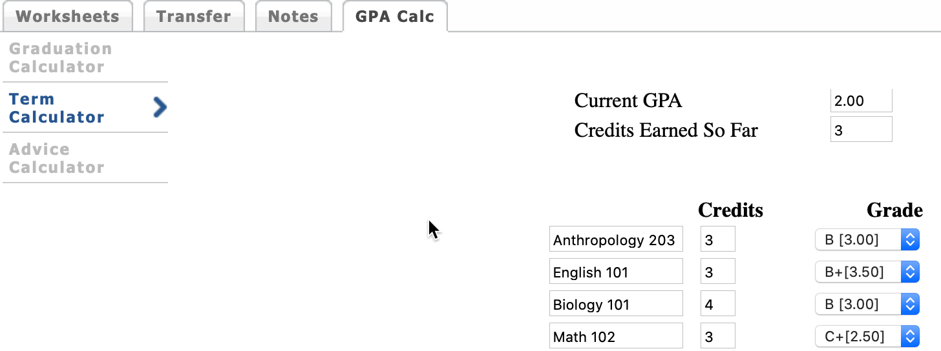
Term Calculator
Use the Term calculator to estimate your end-of-term GPA in relation to the course(s) you are enrolled in and anticipated grades during the current semester.
Click and select Term calculator. Select the final grade(s) you predict you will earn in each class. Note: Your current classes and credits are preloaded into the form. You can also add classes and credits to the list. Click Calculate, to see your projected GPA. Note the system Disclaimer.
This GPA Calculator is for the purposes of estimating your GPA only. The GPA Calculation is not official and will not change your GPA.

Slide 5
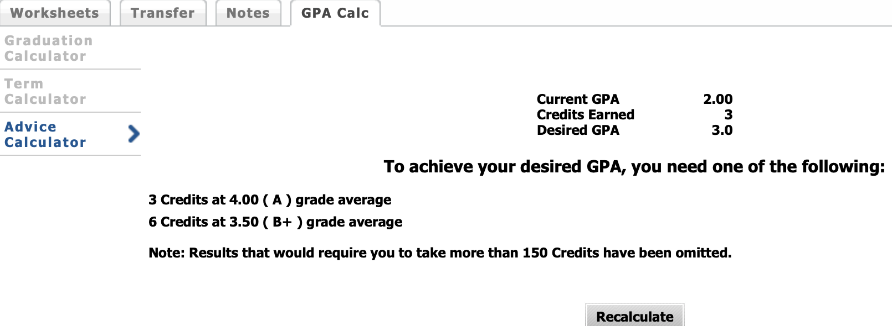
Advice Calculator
Use the advice calculator to estimate the number of credits and grades you need to raise your GPA, achieve honors, or satisfy personal academic aspirations.
Click and select Advice Calculator. Note: your current GPA and credits earned are already entered.
Enter desired GPA.
Click Calculate at bottom of screen or Recalculate to get another estimate.
The displayed number of credit hours and required grade averages indicate if you can achieve your GPA and what pathways you need to follow to attain your desired GPA and improve your academic standing.

