Slide 1
How to search for classes by Part of Term
Full Term, Late Start, Second Half course offerings

Slide 2
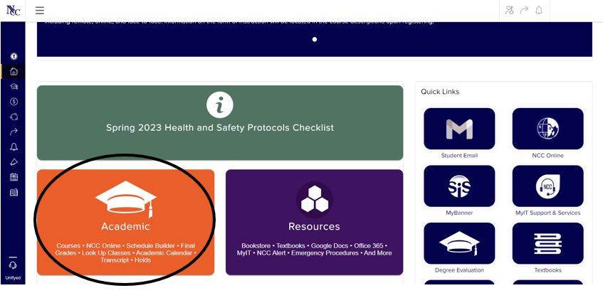
After logging into myNCC, click on Academic

Slide 3
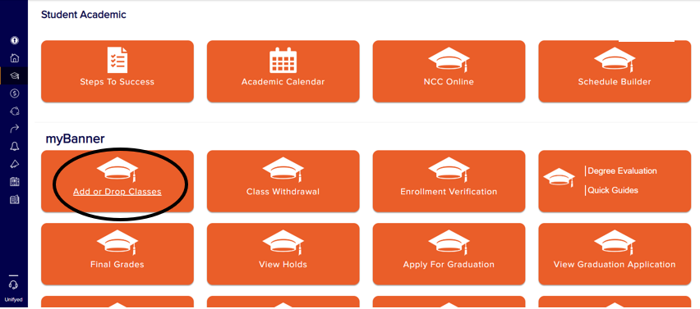
Select Add or Drop Classes

Slide 4
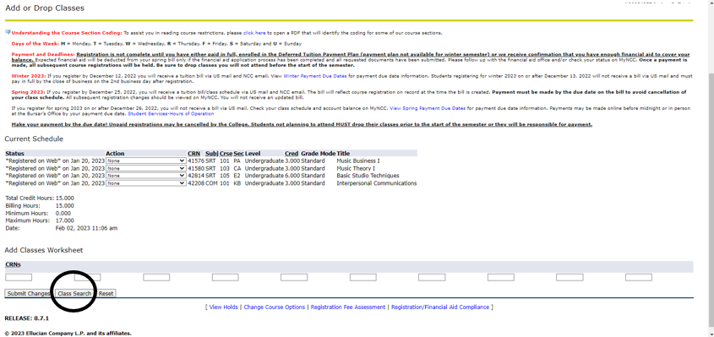
Select Class Search

Slide 5
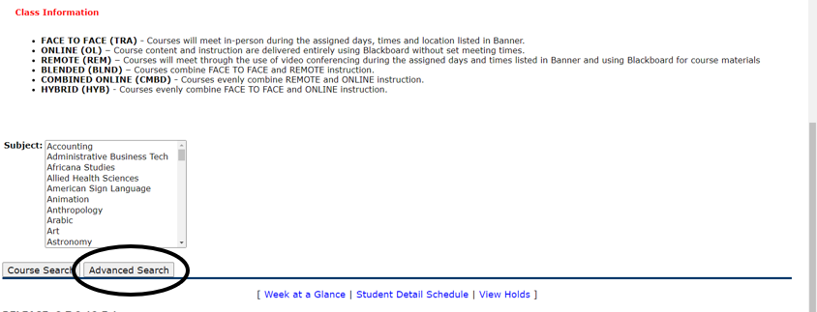
Select Advanced Search

Slide 6
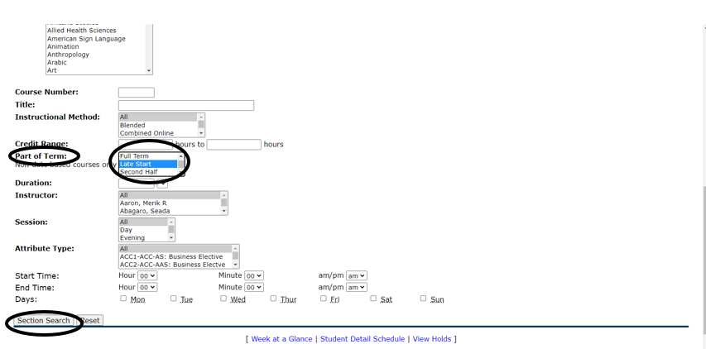
Select a Part of Term and click Section Search

Slide 7
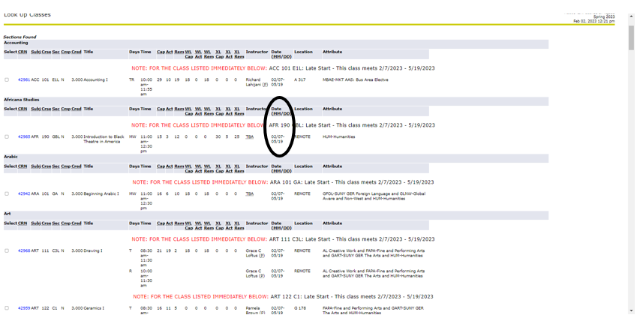
Classes with the selected
Part of Term will display

Slide 8
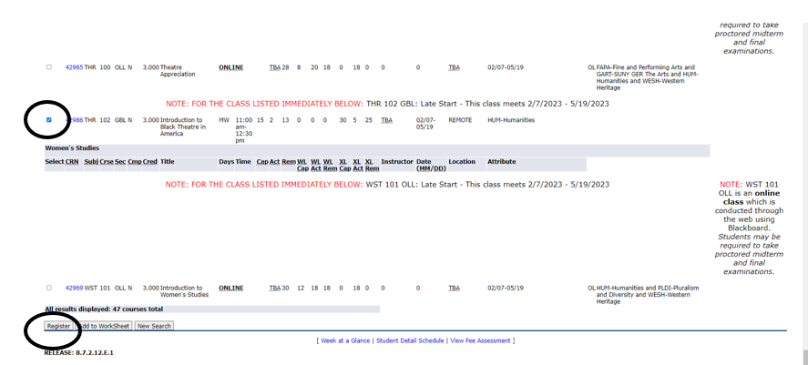
To add the class, check the box and click on Register

