Slide 1

How to Withdraw From a Class in Banner 9

Slide 2
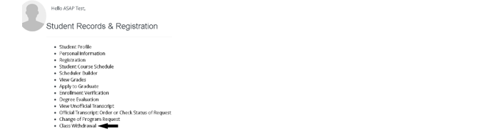
Class Withdrawal from the Landing Page
Select “Class Withdrawal.”

Slide 3
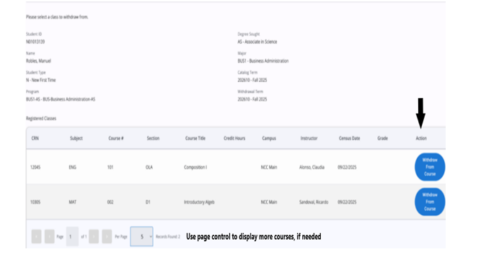
Action Column
Under the Action column select “Withdraw from Course.”

Slide 4
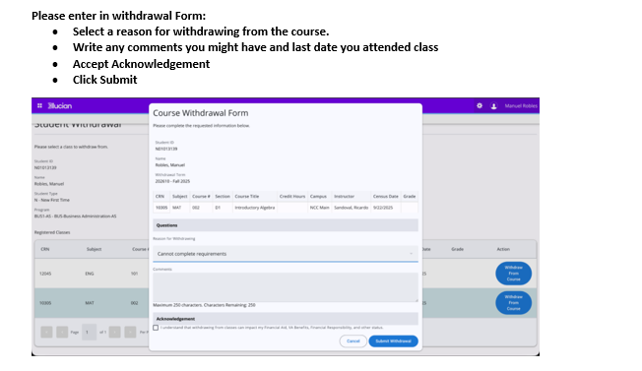
Course Withdrawal Form
Select a reason for withdrawing from the course, write any comments you might have, accept acknowledgement and then click “Submit.”

Slide 5
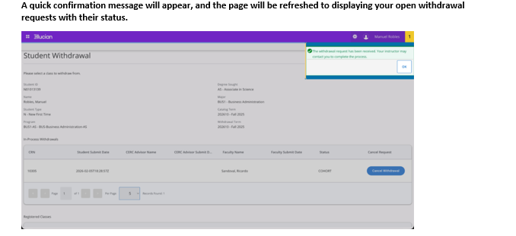
Confirmation
A confirmation message will appear.

Slide 6
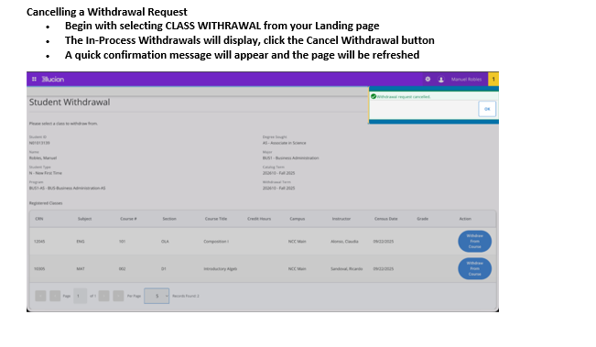
How to Cancel a Withdrawal Request
Select Class Withdrawal from your landing page, click the blue button “Cancel Withdrawal button” and then a confirmation message will appear.

