Slide 1
How to Make Changes to Your Schedule

Slide 2
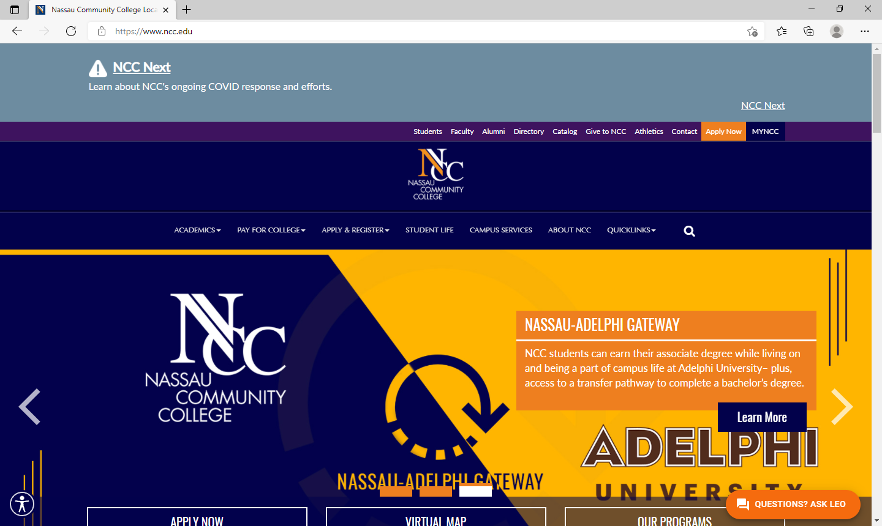
www.ncc.edu homepage
Select
MYNCC

Slide 3
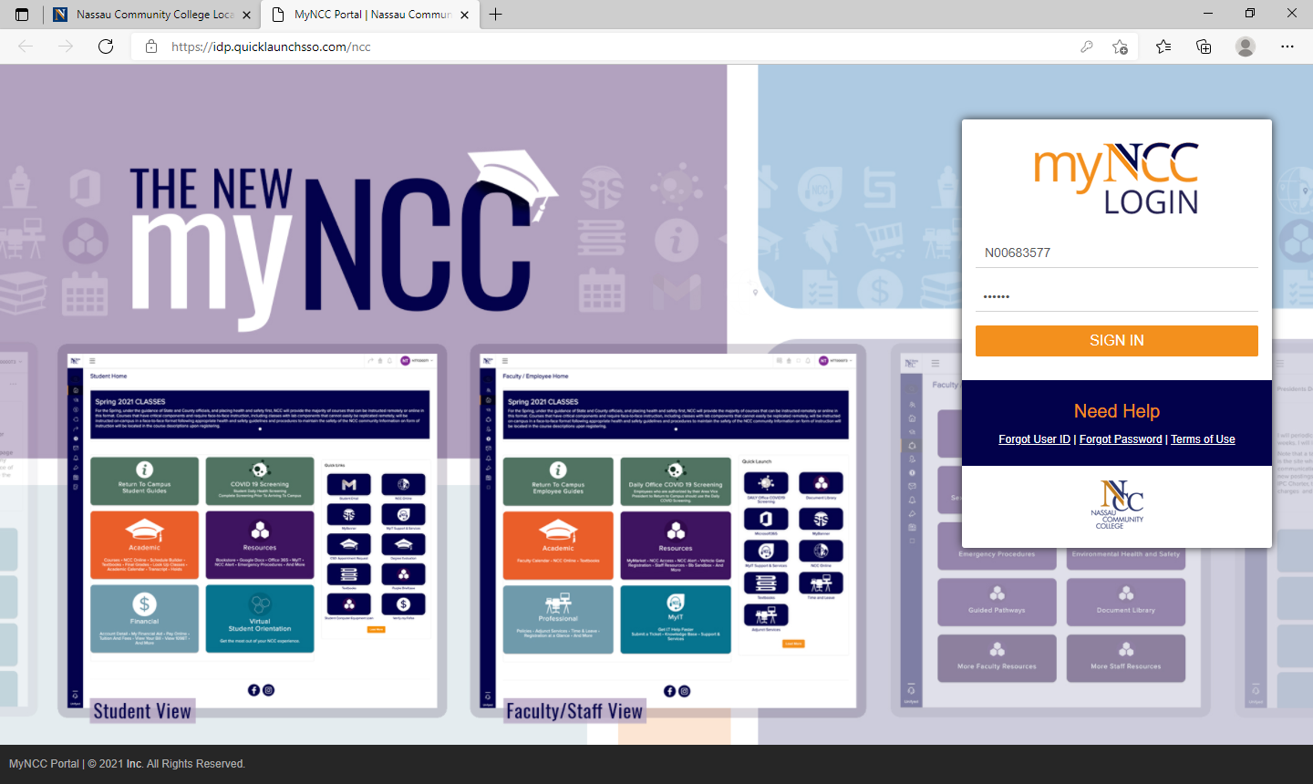
myNCC Login page
Log into myNCC Portal
USERNAME: NCC ID N00_ _ _ _ _ _
PASSWORD: 6-digit DOB

Slide 4
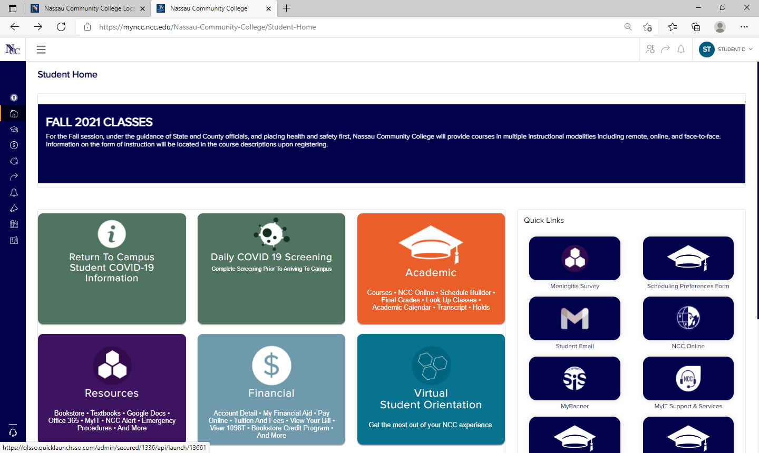
myNCC Student Home
Select Academic

Slide 5
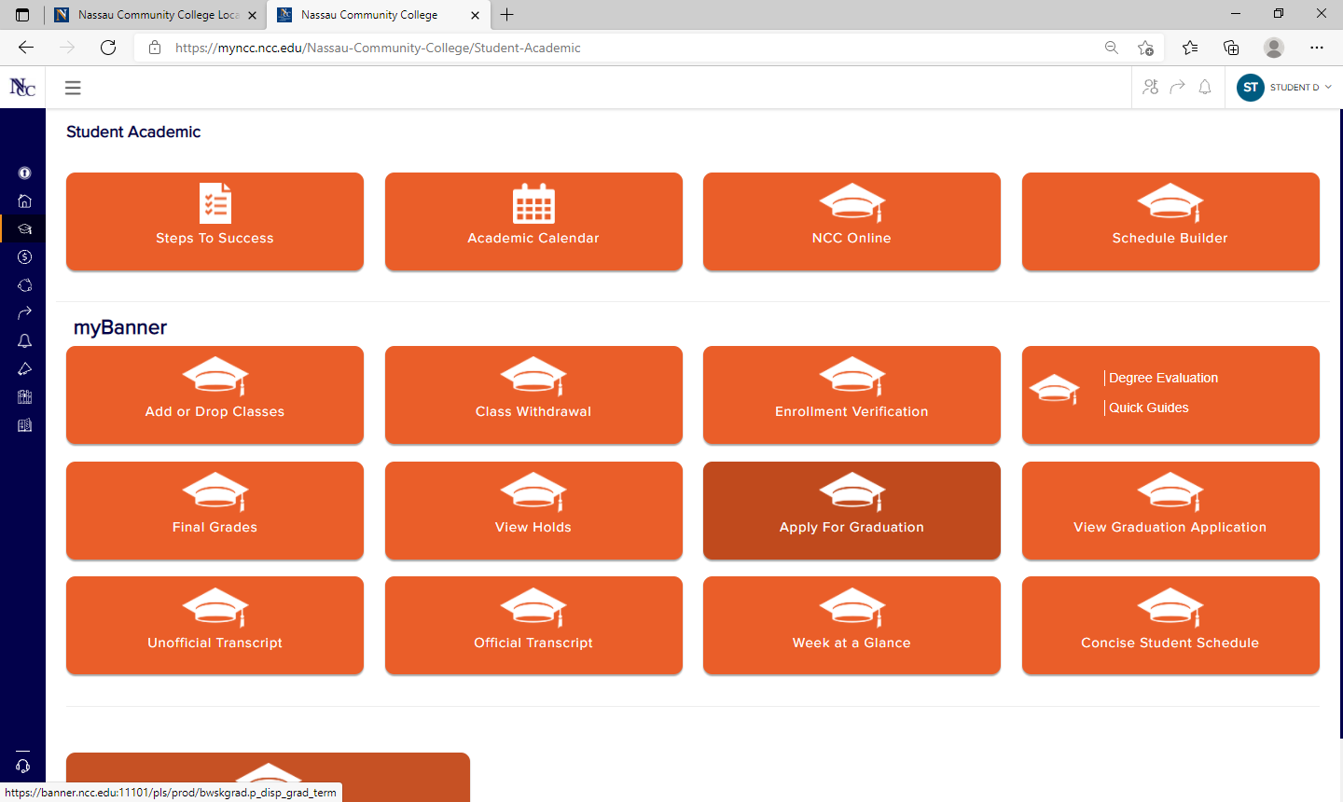
Add or Drop Class from Student Academic page
Under myBanner, Select Add or Drop Classes

Slide 6
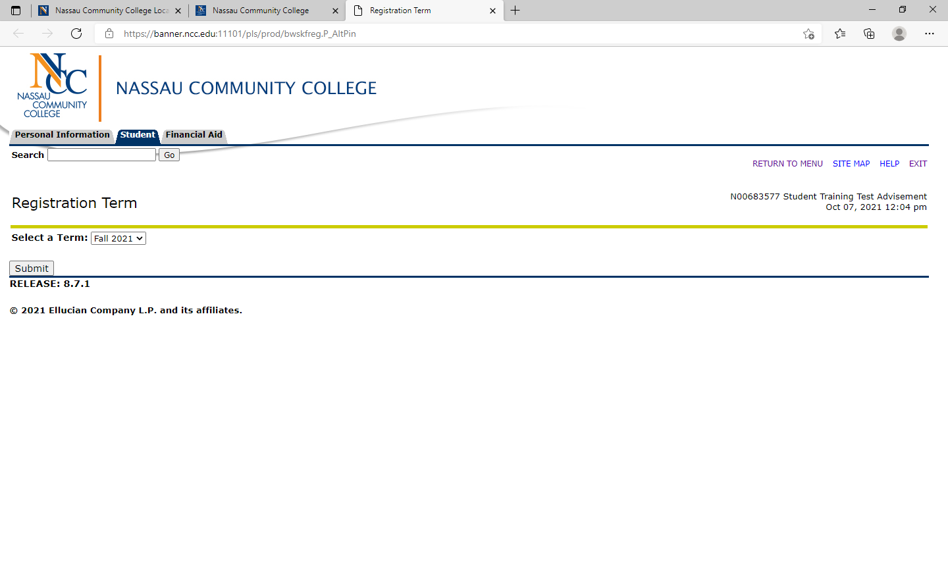
Select Registration Term
Select Term from drop menu
After selecting term, click on Submit

Slide 7
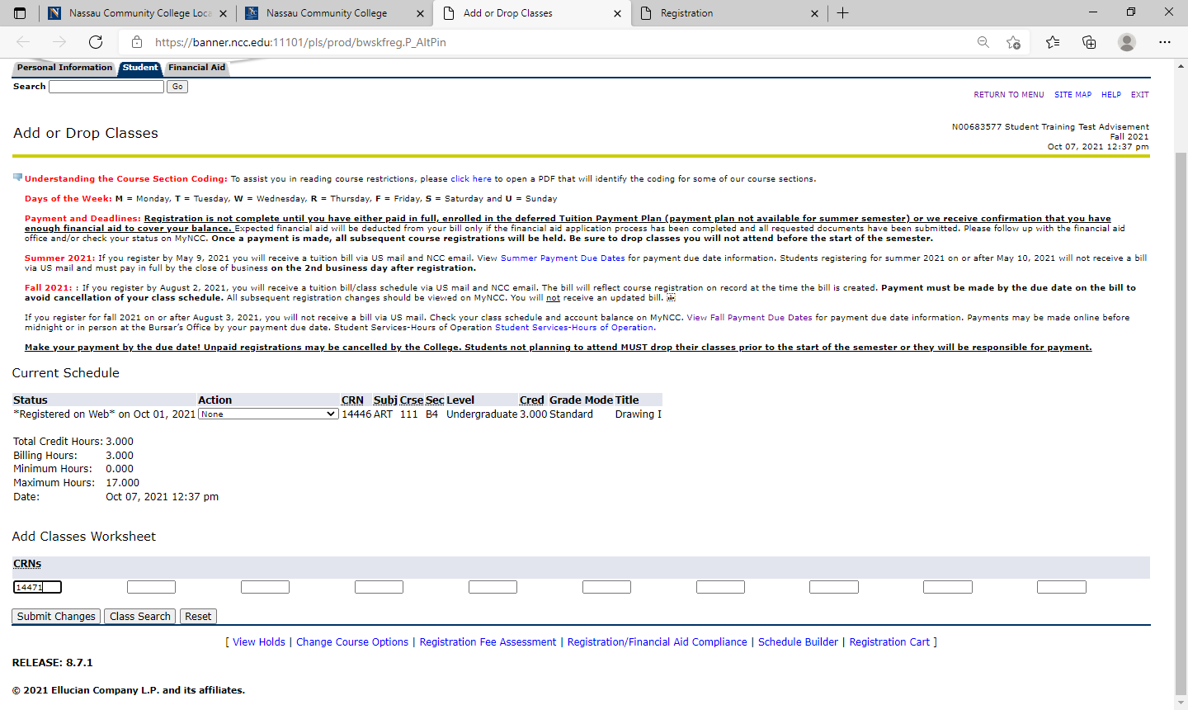
To Add Classes with the CRN
If you know the CRN add the number to the cell
After adding the CRN Submit Changes

Slide 8
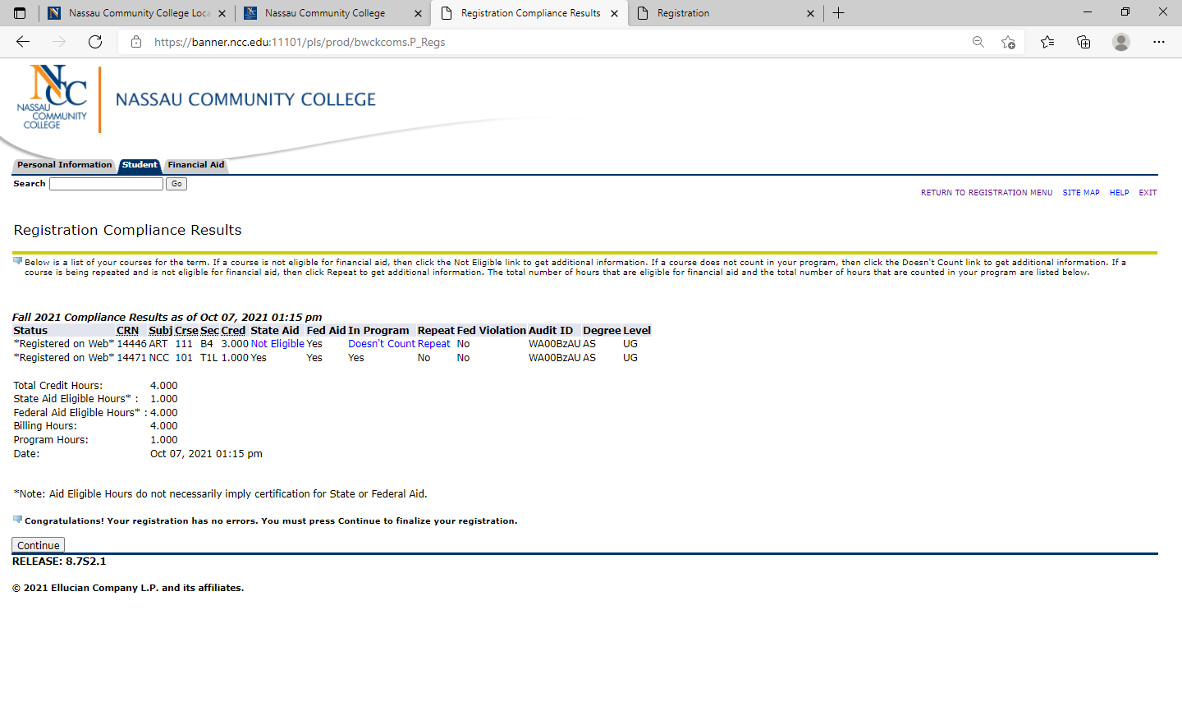
Registration Compliance Results
A message will indicate if the course added is in compliance for financial aid, program and if it’s a repeated course
Select Continue

Slide 9
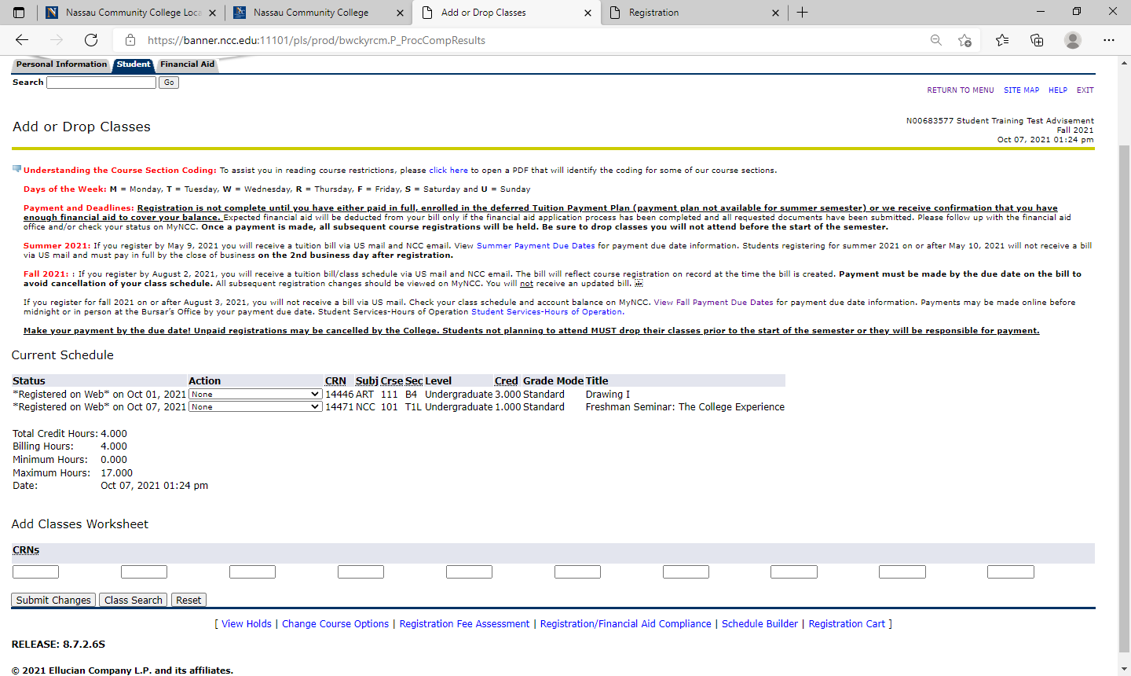
How to Search for a Course, if you don’t know the CRNs
Select Class Search

Slide 10
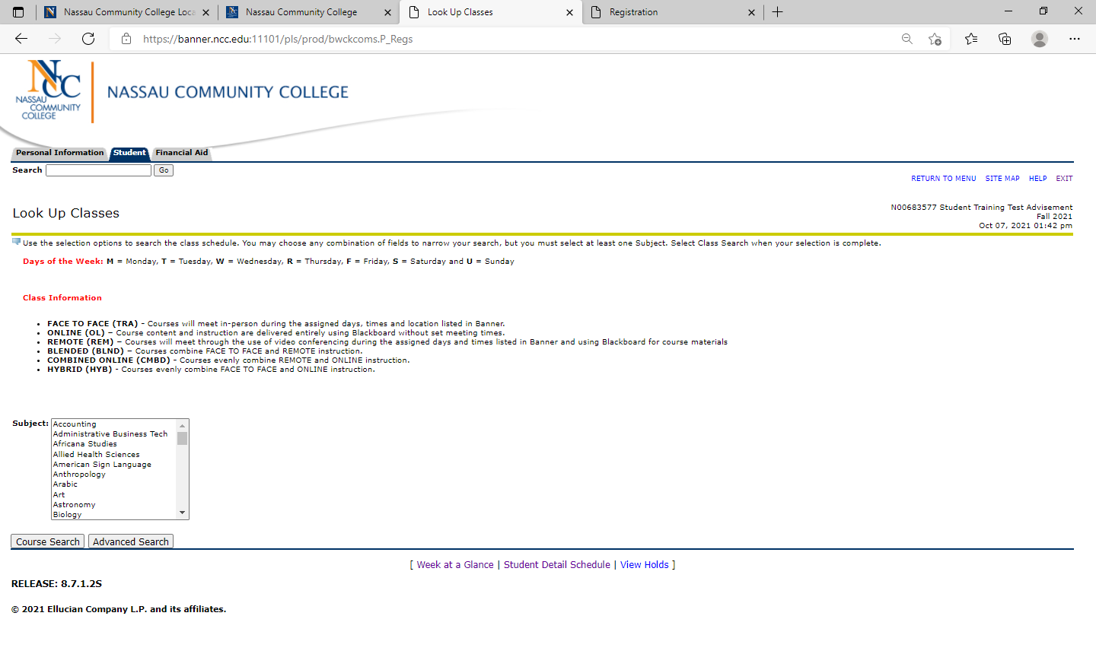
Choose “Course Search” or “Advance Search” in the Look Up Classes
Select a Subject from the menu and click Course Search to view the list of courses
Select Advance Search to narrow your selection by Instructional Method, Part of Term, Attribute Type, etc.

Slide 11
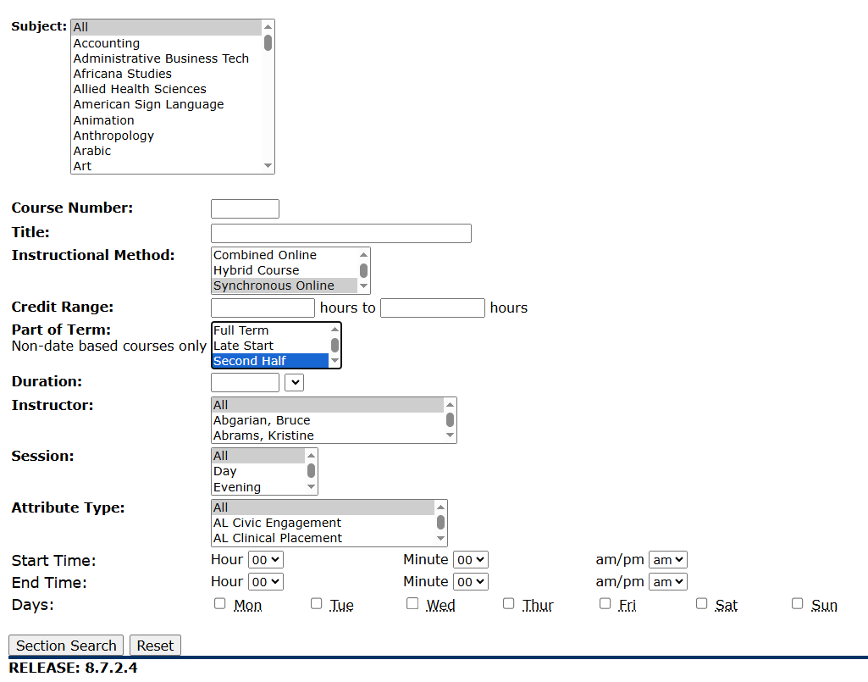
Look up Classes under Advance Search
Select as many options from the menu by highlighting areas of interest.
Popular Selections Include:
Subject
Course Number
Instructional Method: Asynchronous Online, Synchronous Online, Traditional FACE to FACE
Part of Term: Full Term, Late Start, Second Half
Attribute Type: SUNY GER
Select Section Search to see results

Slide 12
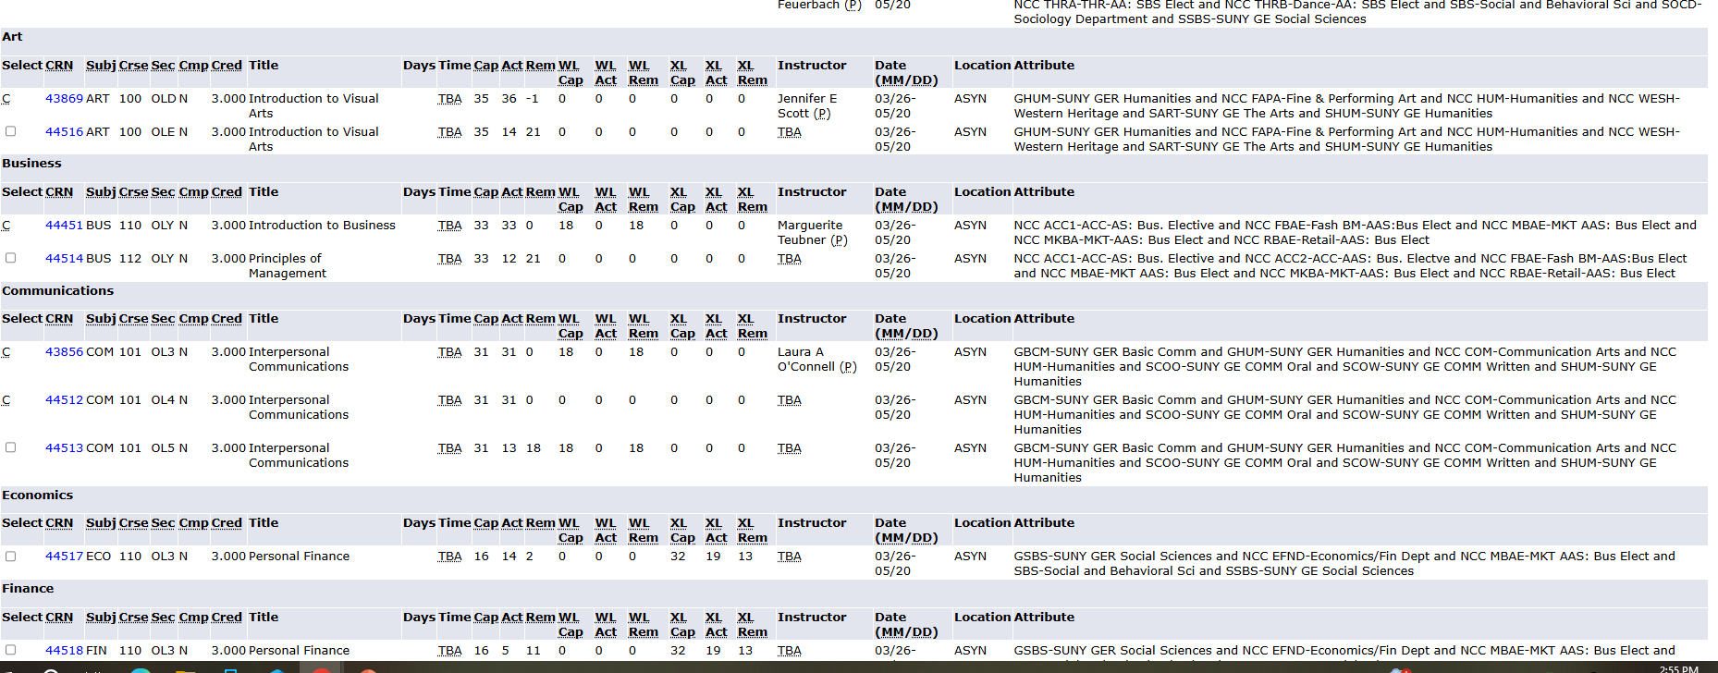
Sections Found Under Look Up Classes
Results explained:
Box for open classes
CRN, Subject, days, time, Instructor
DATE: start and end date
Location for Instructional Method
Attribute Type

Slide 13
Instructional Method
Class Information
FACE TO FACE (TRA) – Courses meet in-person during the assigned days, times and location listed.
ASYNCHRONOUS ONLINE (ASYN) – Course content and instructions are delivered entirely web-based using the college’s Learning Management System (LMS) without set meeting times. (Formerly called ONLINE.)
SYNCHRONOUS ONLINE (SYNC) - Courses meet in real-time through video conferencing during the assigned days and times listed, using the college’s LMS for course materials. (Formerly called REMOTE.)
HYBRID (HYB) – Courses evenly combine FACE TO FACE and ASYNCHRONOUS ONLINE instruction.
BLENDED (BLND) - Courses combine FACE TO FACE and SYNCHRONOUS ONLINE instruction.
COMBINED ONLINE (CMBD) – Courses evenly combine ASYNCHRONOUS ONLINE and SYNCHRONOUS ONLINE instruction.

Slide 14
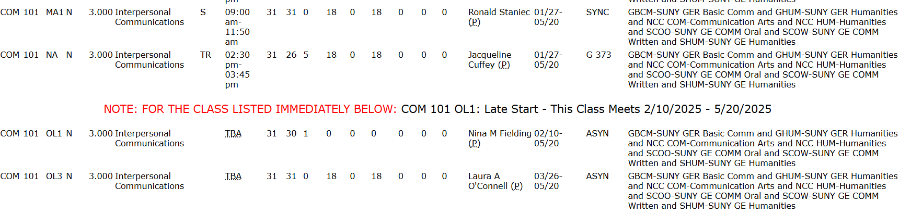
Instructional Method displayed Under Location
Synchronous Online Courses will meet through BrightSpace video conferencing during the assigned days and times listed in Banner.
Face to Face Courses will meet in-person during the assigned days, times and location listed in Banner.
Asynchronous Online (OL) Course content and instruction are delivered entirely using BrightSpace without set meeting times.

Slide 15
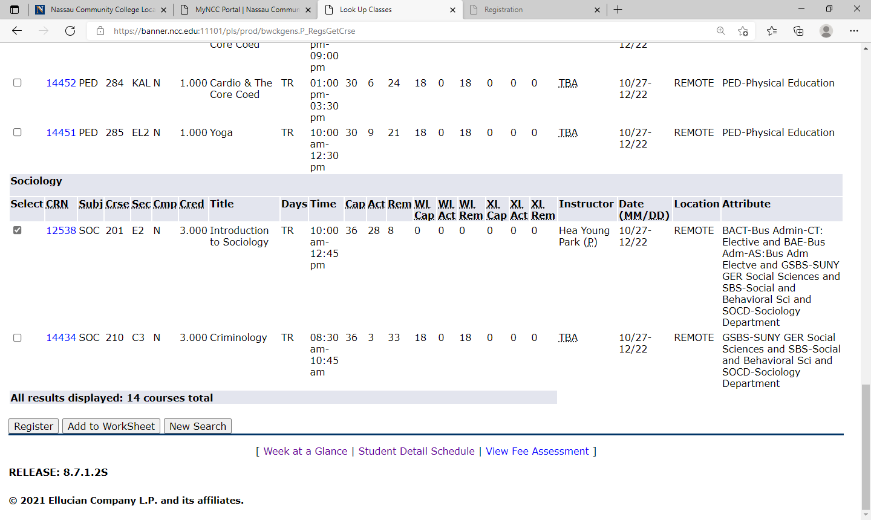
Select Class to Add to WorkSheet
Select box for class
Select Add to WorkSheet

Slide 16
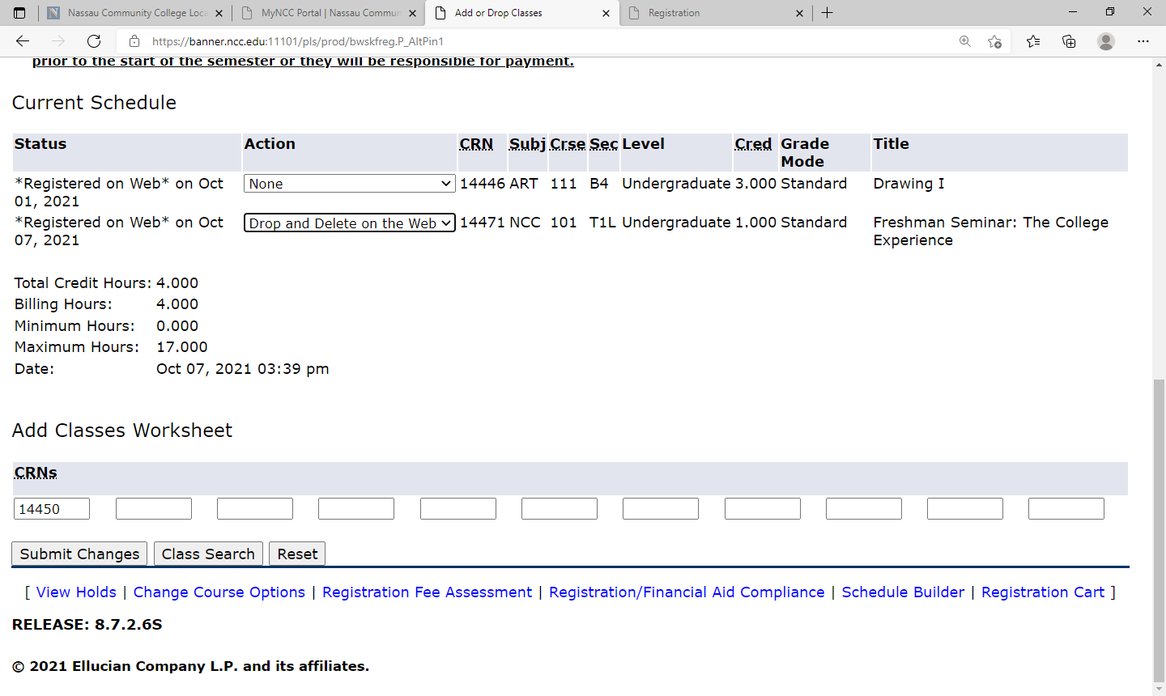
To Swap Classes Prior to the Start of the Semester or During the Drop/Add period
CRNs is added by selecting worksheet
Under Action
Select Drop and Delete on the Web
Submit Changes

Slide 17
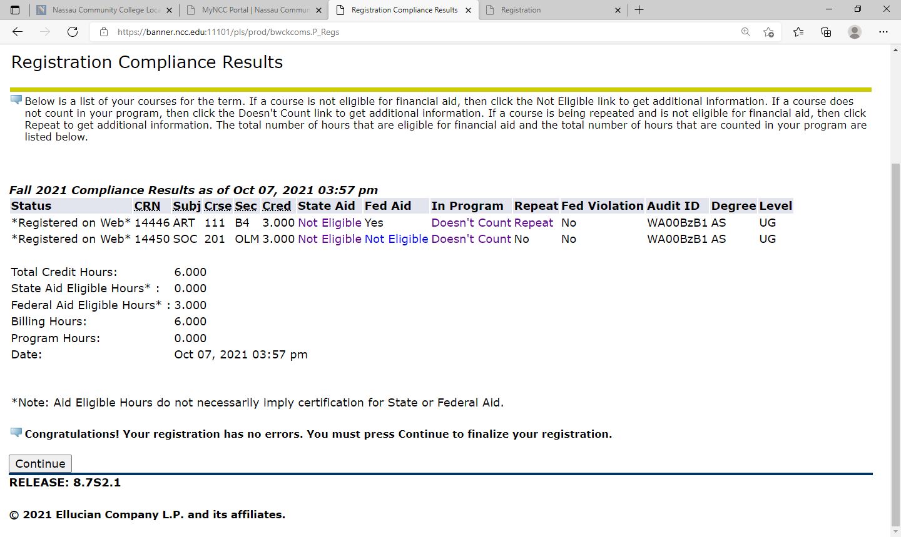
Registration Compliance Results
Changes and Message Displayed
Select Continue

Slide 18
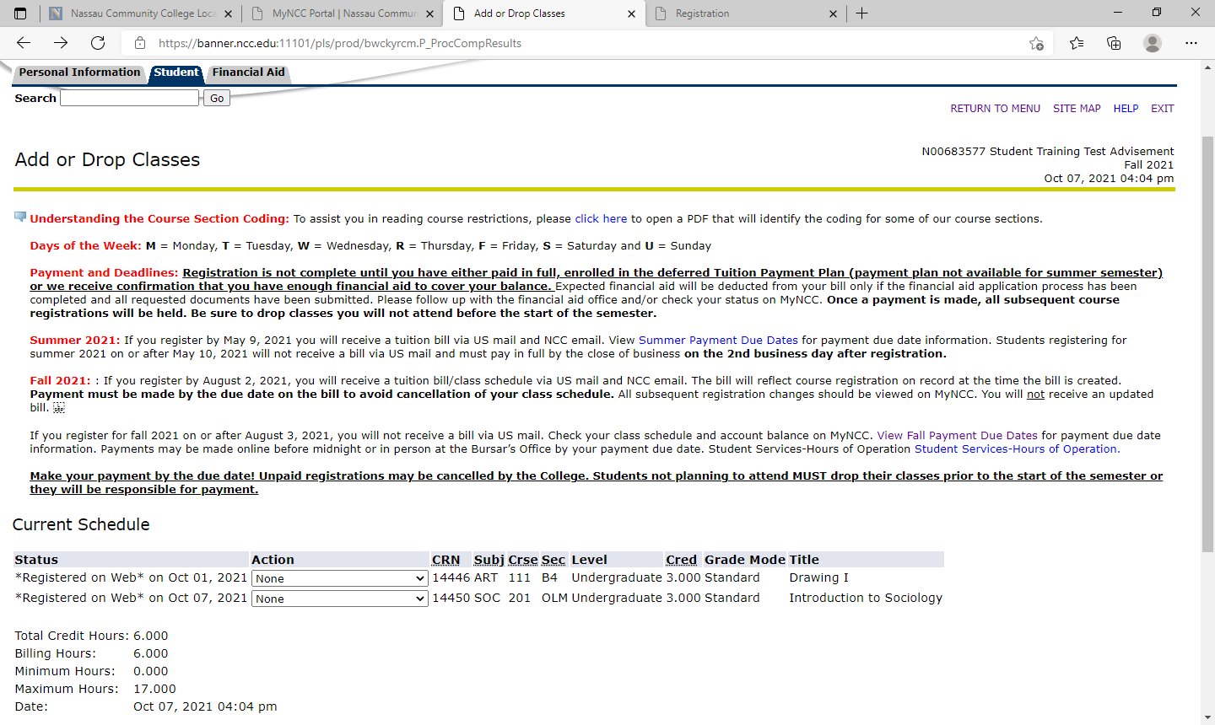
To View Schedule
Select RETURN TO MENU

Slide 19
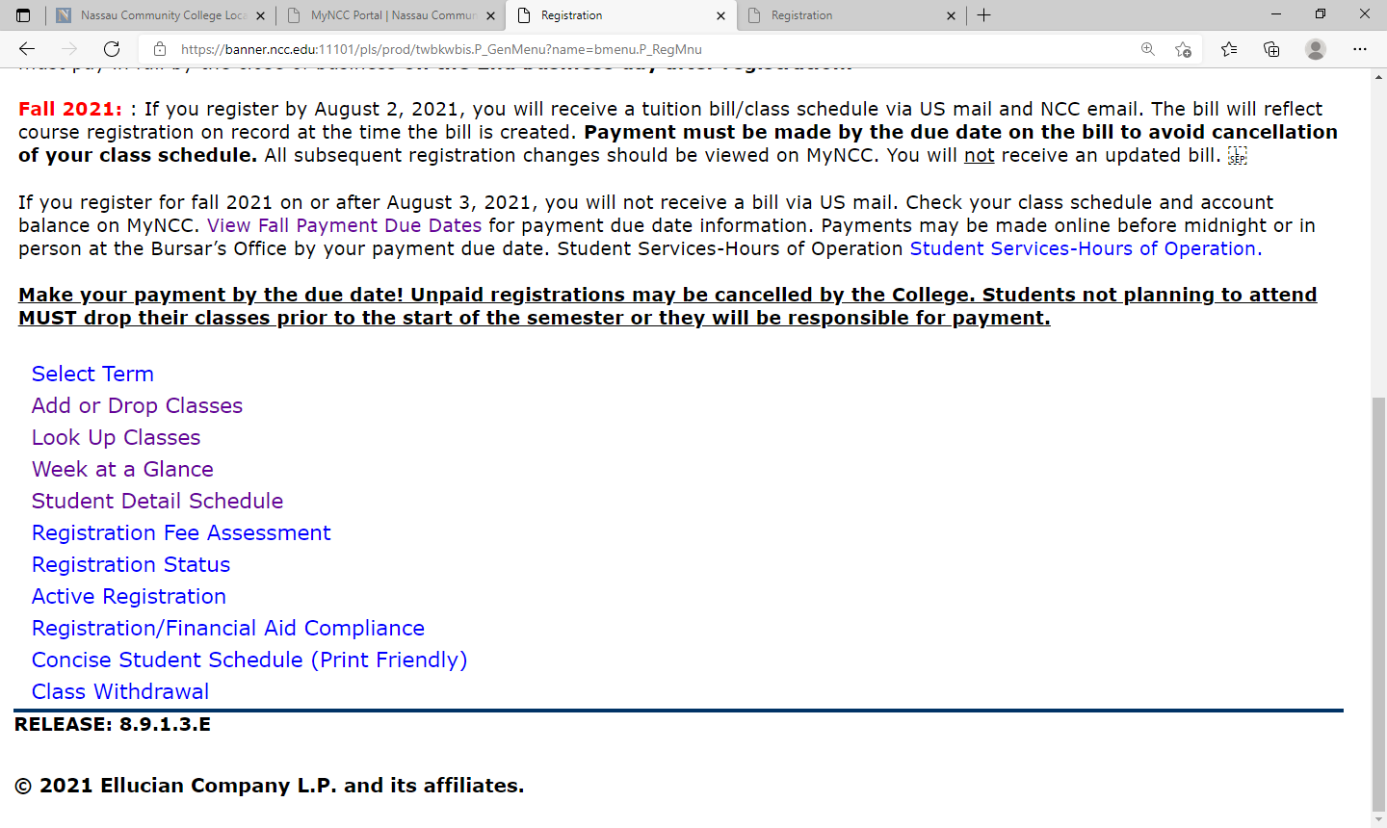
Different Options to View Schedule
Recommended option Concise Student Schedule (Print Friendly)

Slide 20
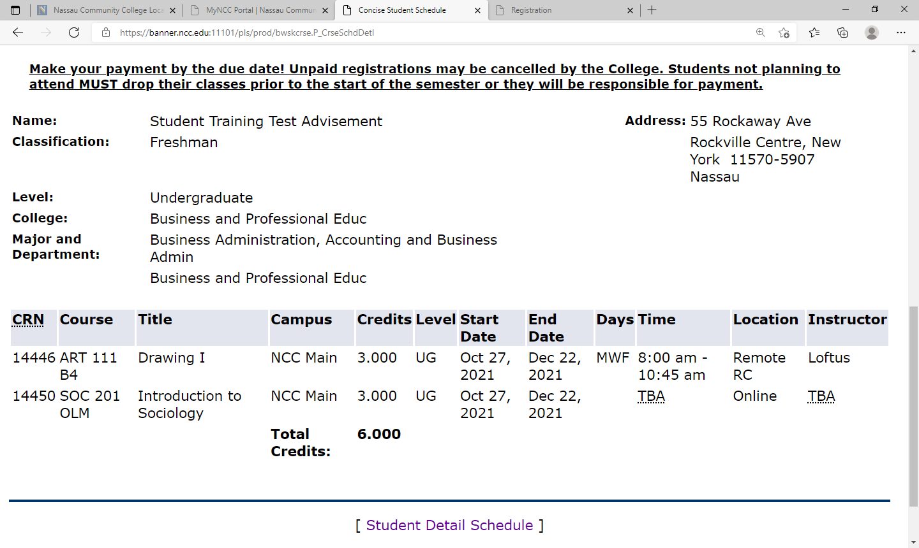
Concise Student Schedule

