Slide 1
How to search for classes by Instructional Method
Asynchronous Online, Synchronous Online, Traditional Face-to-Face

Slide 2
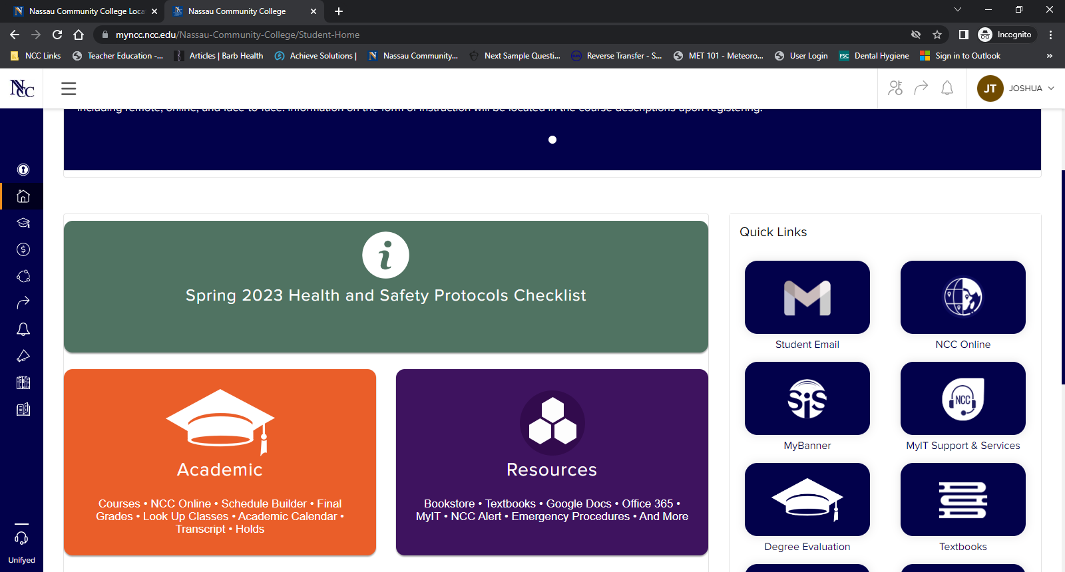
After logging into myNCC, click on Academic

Slide 3
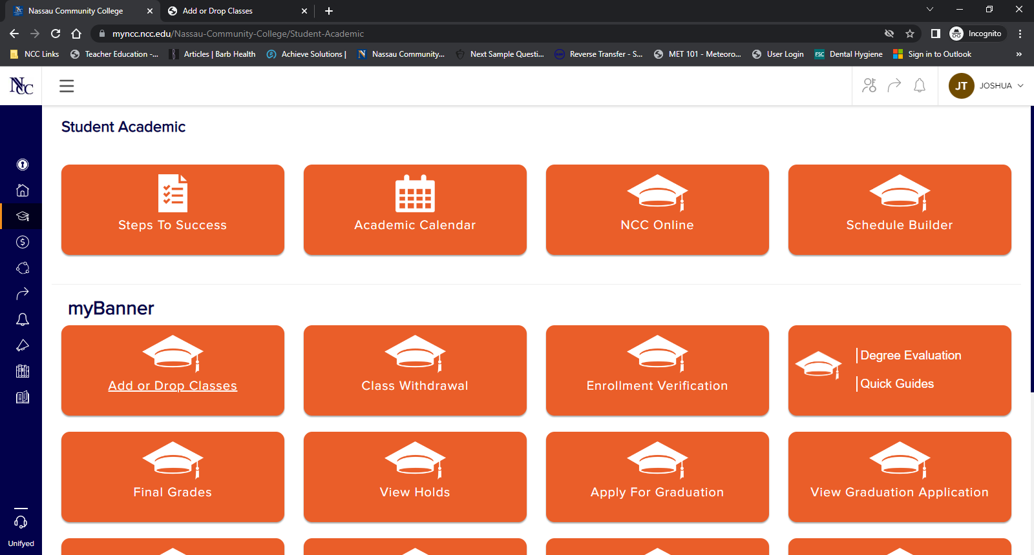
Select Add or Drop Classes

Slide 4
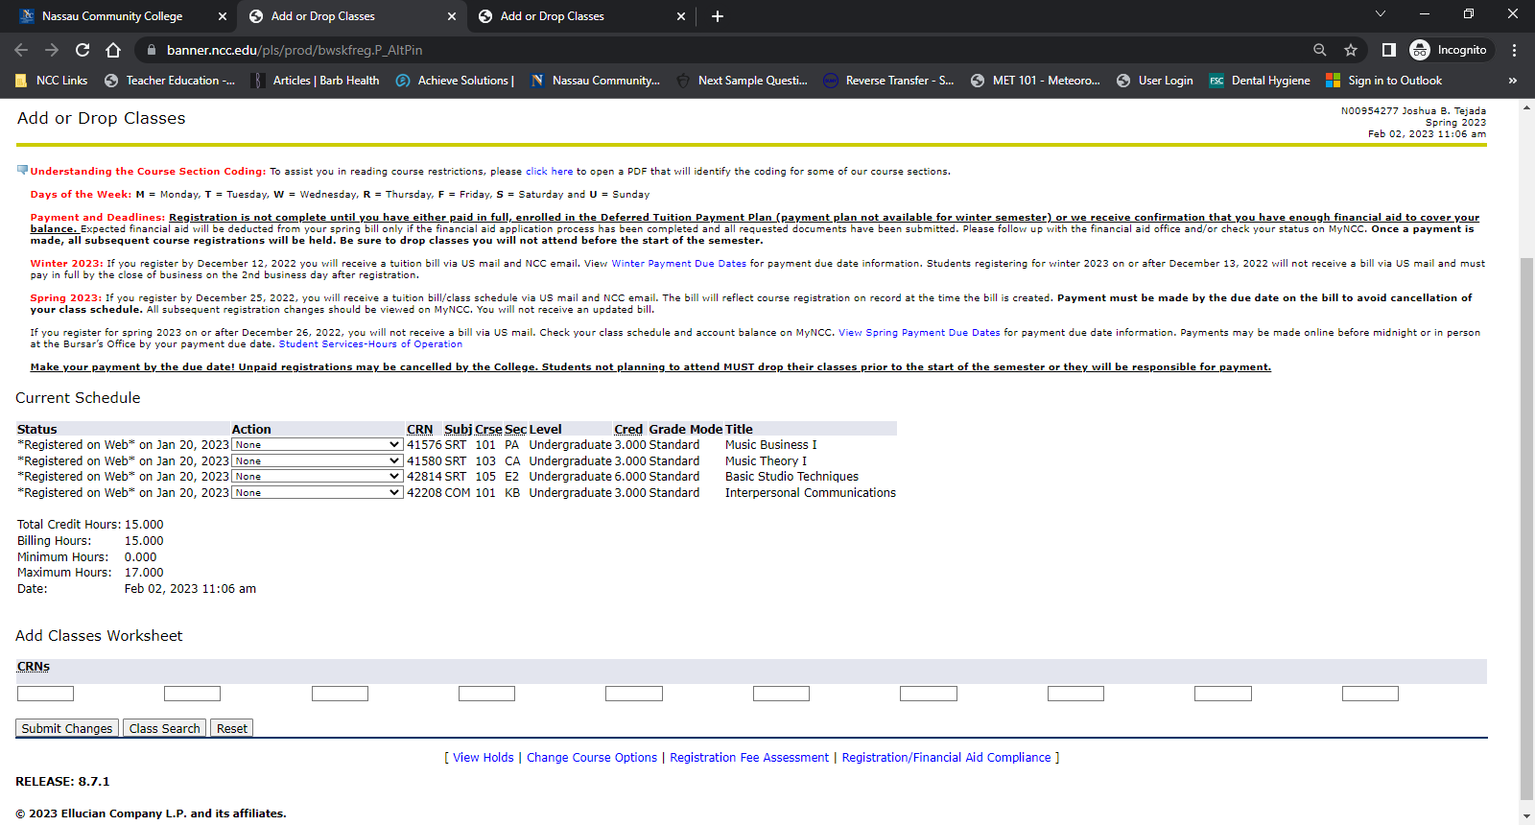
Select Class Search

Slide 5
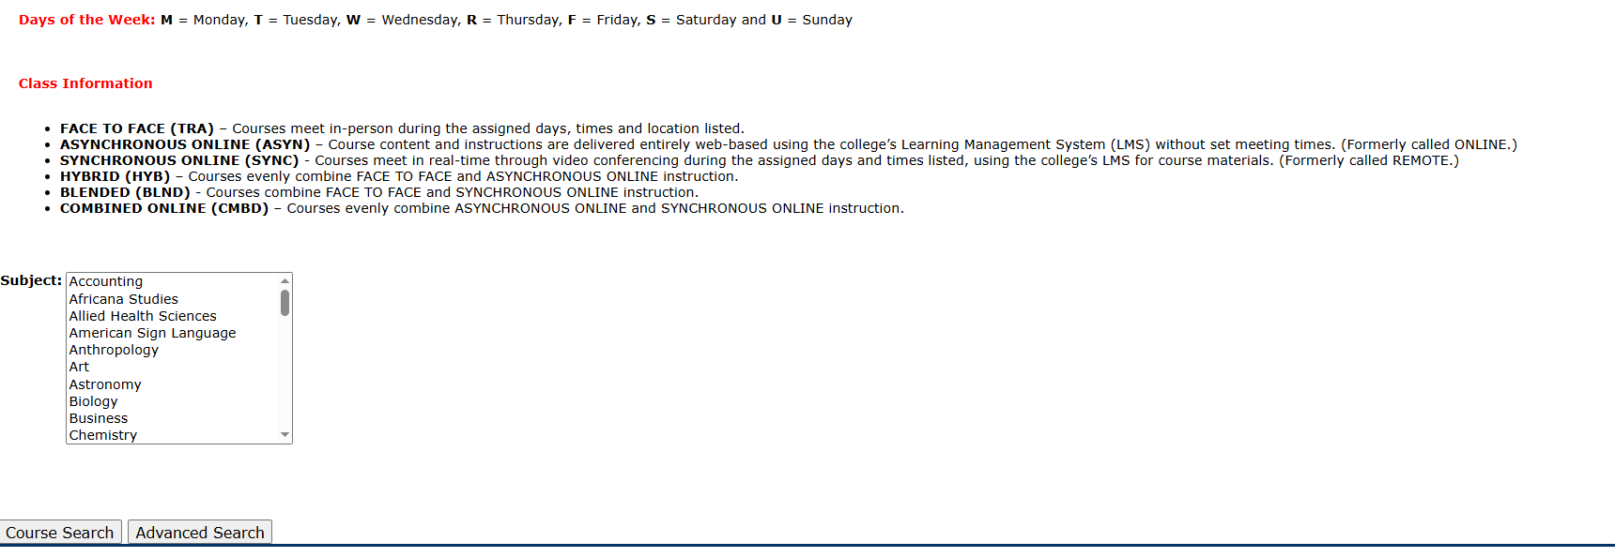
Select Advanced Search

Slide 6
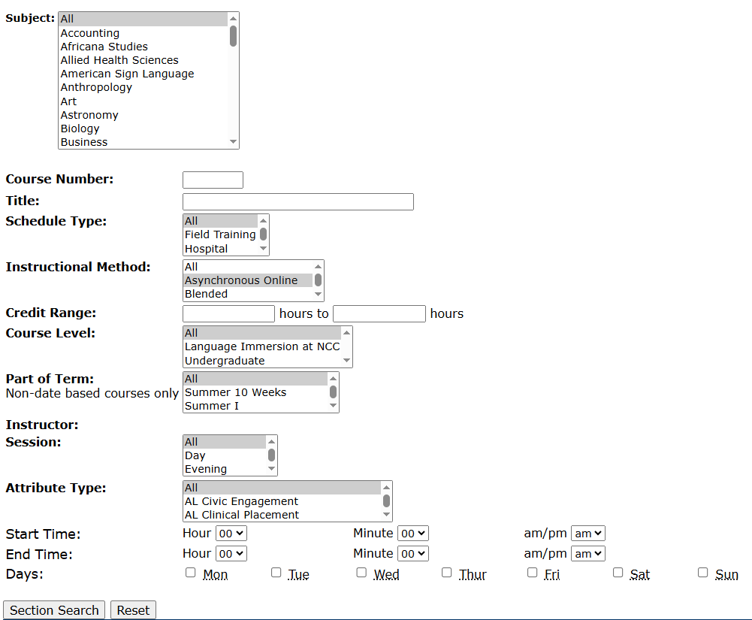
Select an Instructional Method. Highlight your preferred method; Asynchronous Online, Synchronous Online, Traditional Face to Face.
Then click on Section Search

Slide 7
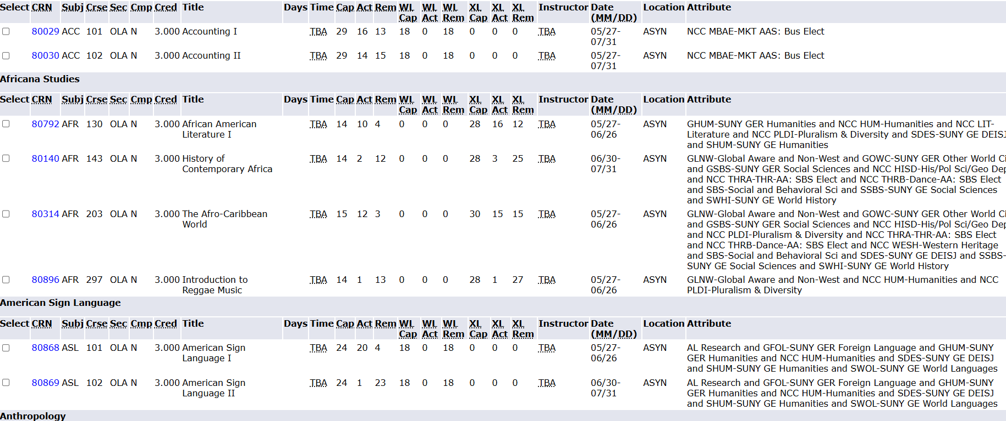
Classes with the selected
Instructional Method will display

