Slide 1
Degree Evaluation - Using GPA Calculators and Class History

Slide 2
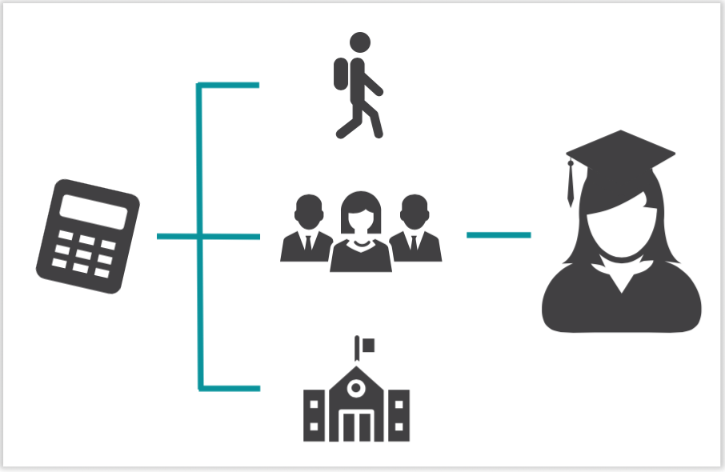
Set Goals With GPA Calculators
Each of a Degree Evaluations’ GPA Calculators are designed to deliver insights into academic performance and program completion.
GPA calculators can help
Set realistic Goals for a term
Calculate a final GPA based on current grades
Develop an action plan for avoiding academic probation

Slide 3
Access GPA Calculators
Access Degree Evaluation GPA Calculators by clicking the Ellipsis (to the right of the email icon and underneath the username).
From the menu, select GPA Calculator.
Degree Evaluation contains three types of GPA Calculators. They are the Graduation Calculator, Term Calculator and Advice Calculator.

Slide 4
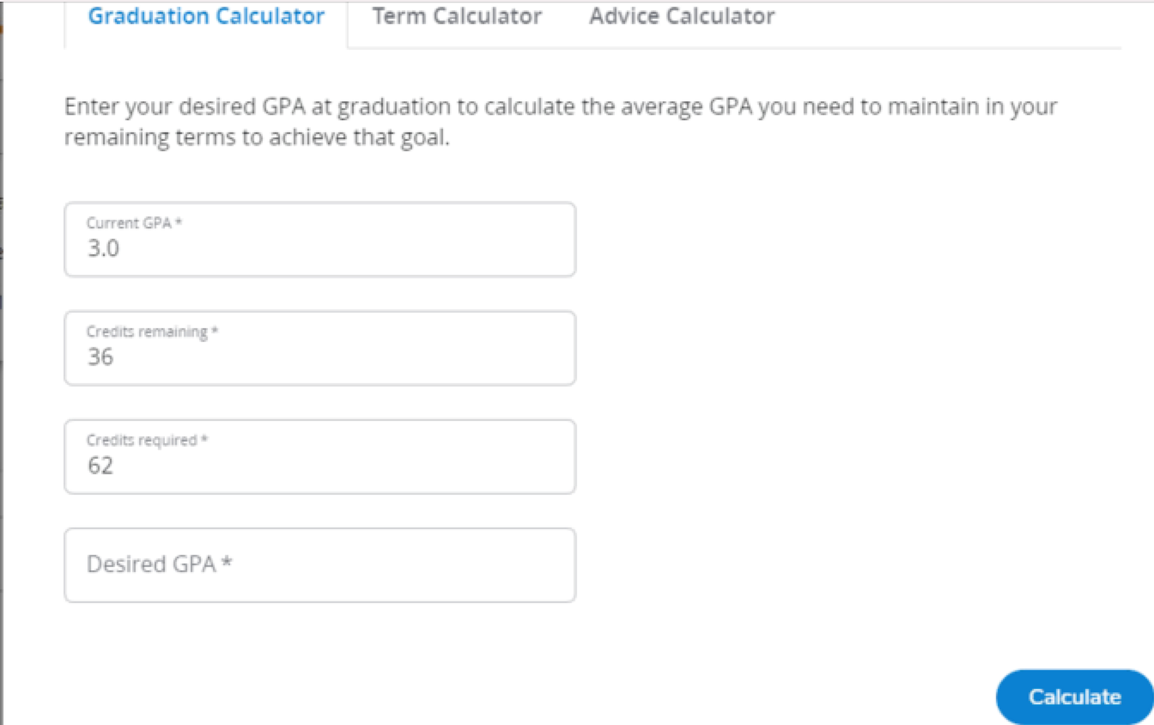
Graduation Calculator
The Graduation Calculator lists your current GPA, number of credits remaining, and number of credits required. Enter your desired GPA.
It returns the average GPA required, over the remaining credits for you to graduate with the desired GPA.

Slide 5
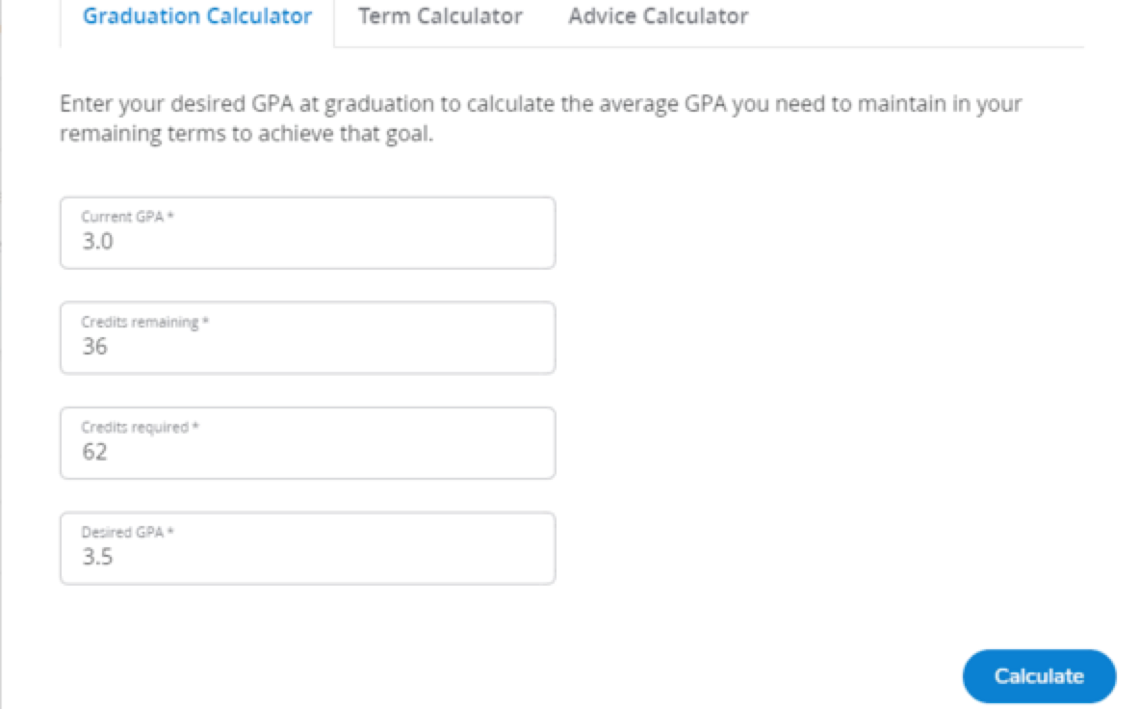
Graduation Calculator Example
For example, what average GPA would you need to maintain with a 3.0 GPA, over the remaining 36 credits in a 62-credit Associate Degree program, to graduate with a 3.5?
After entering the desired GPA information, click the Calculate button.

Slide 6
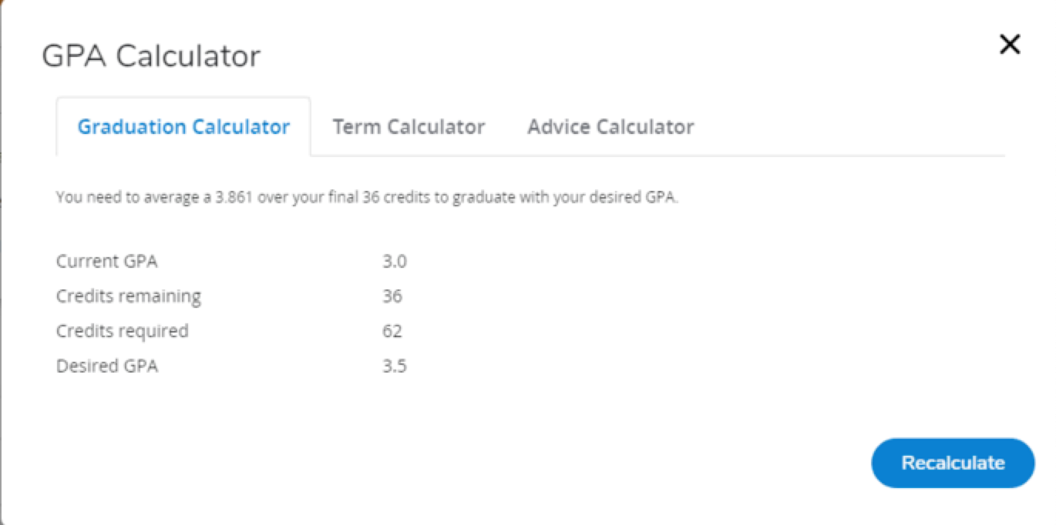
Graduation Calculator Result
The Graduation Calculator advises you to maintain a 3.861, over your final 36 credits, to graduate with a 3.5 GPA.
In this case, the Graduation Calculator could help you plan to graduate with honors.
The Graduation Calculator helps you graduate with a specific GPA.

Slide 7
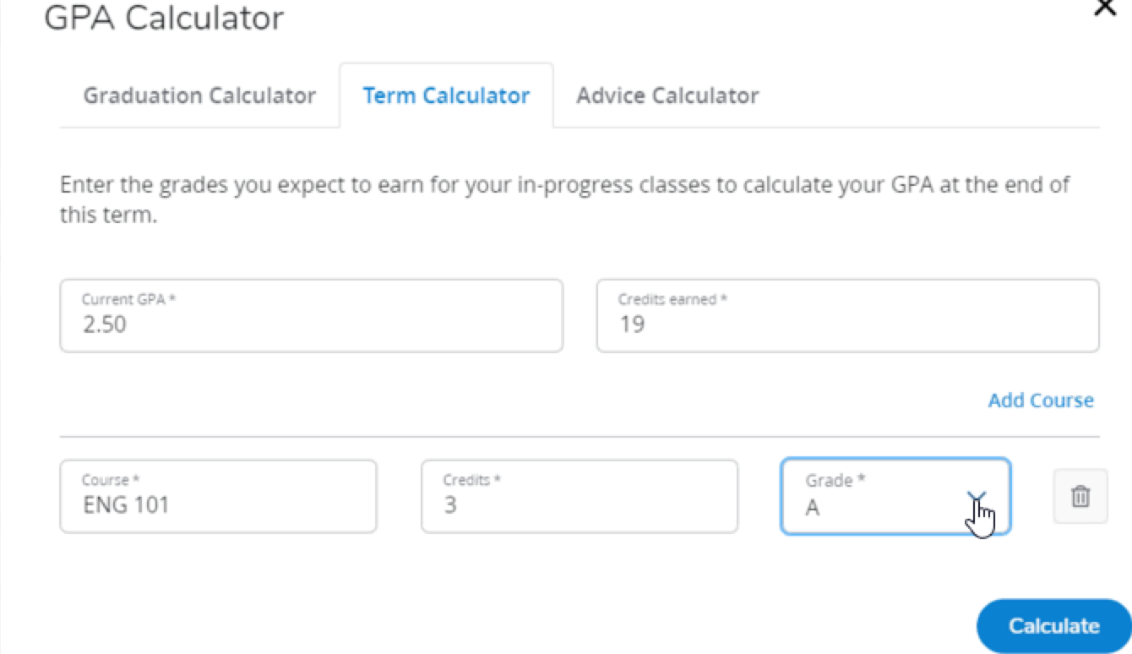
Term Calculator
The Term Calculator lists your current GPA and number of credits earned.
It prompts you to add grade expectations for each of the term’s In progress courses listed.
Then the Term Calculator returns the expected end-of-term GPA.

Slide 8
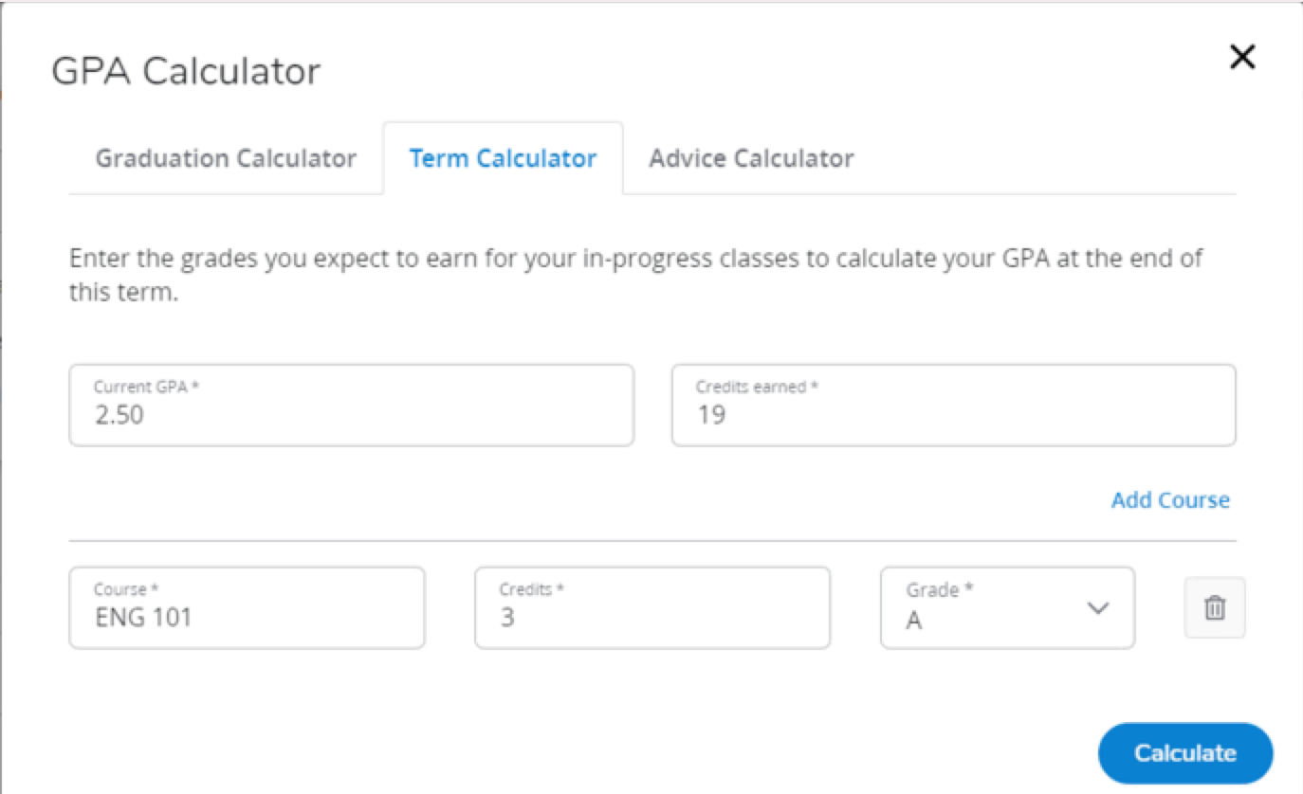
Term Calculator Example
For example, what would your end-of-term GPA be if you have a GPA of 2.5, completed 19 credits and plan to complete Eng101 for 3 credits with a grade of A.
After entering the grade information for each course listed, click the Calculate button.

Slide 9
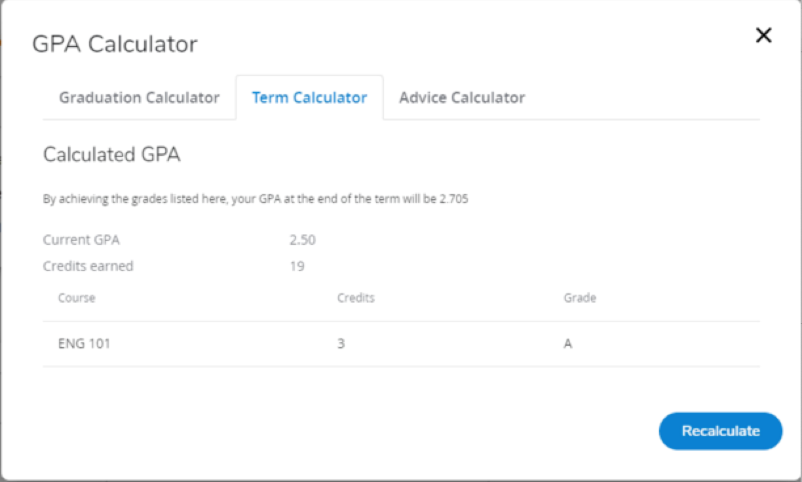
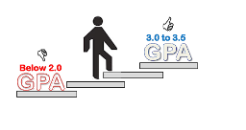
Term Calculator Result
The Term Calculator advises you that the end-of-term GPA will be 2.705 if you achieve the expected grade.
In this case, the Term Calculator could help you avoid academic probation.
The Term Calculator helps avoid or meet a GPA

Slide 10
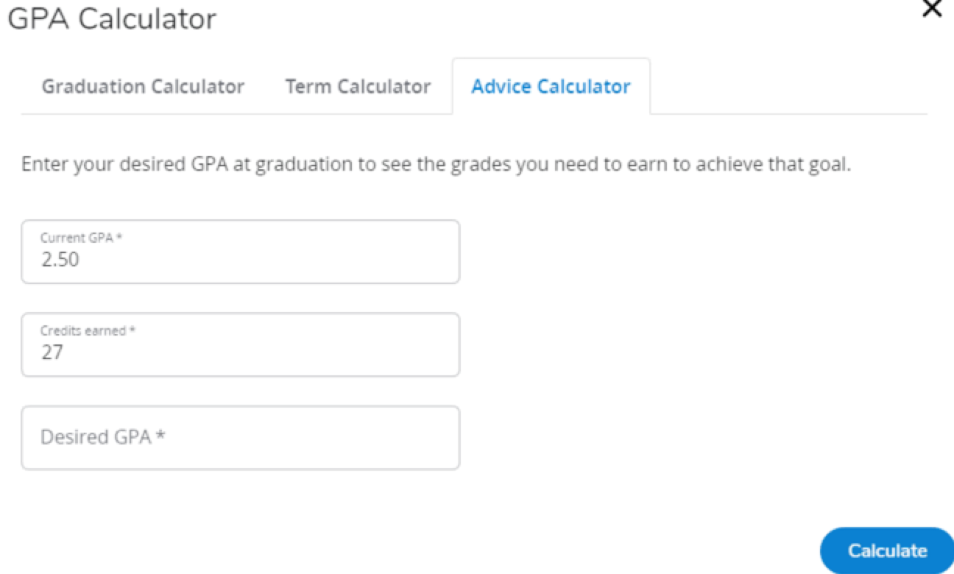
The Advice Calculator
The Advice Calculator lists your current GPA and number of credits earned. Enter desired GPA.
It returns advice on how many credits to complete and with which grades, to achieve the desired GPA.

Slide 11
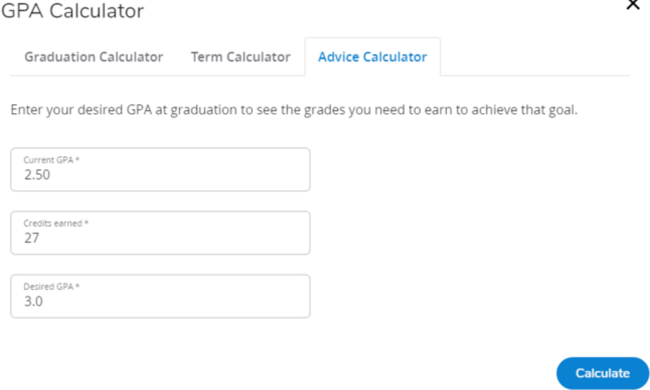
Advice Calculator Example
For example, what would you need to do with a current GPA of 2.50 and 27 credits to achieve a 3.0 GPA?
After entering the desired GPA information, click the Calculate button.

Slide 12
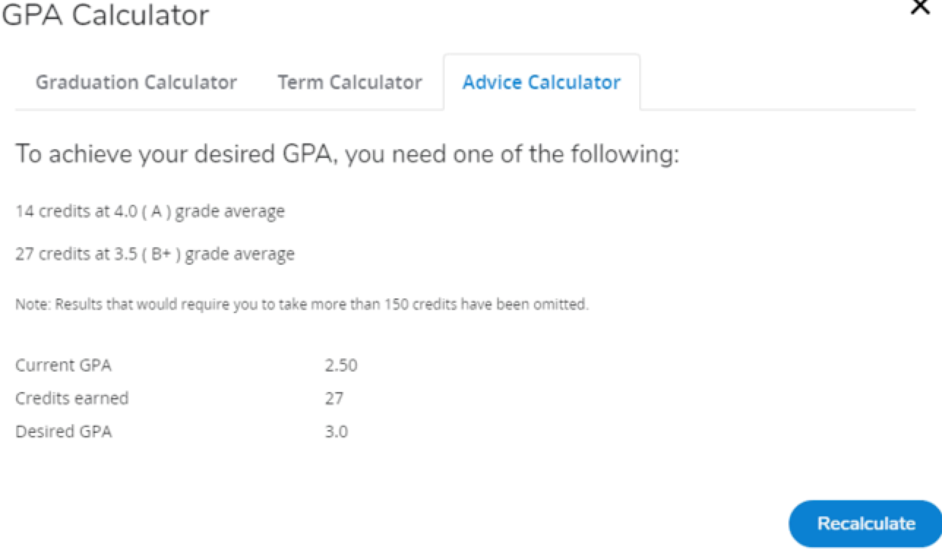
Advice Calculator Result
The Advice Calculator renders multiple scenarios that meet the desired GPA goal.
In this case, the Advice Calculator could help you continuously monitor and revise your plan to meet your goals.
The Advice Calculator helps continuously monitor and revise a plan to meet GPA goals.

Slide 13
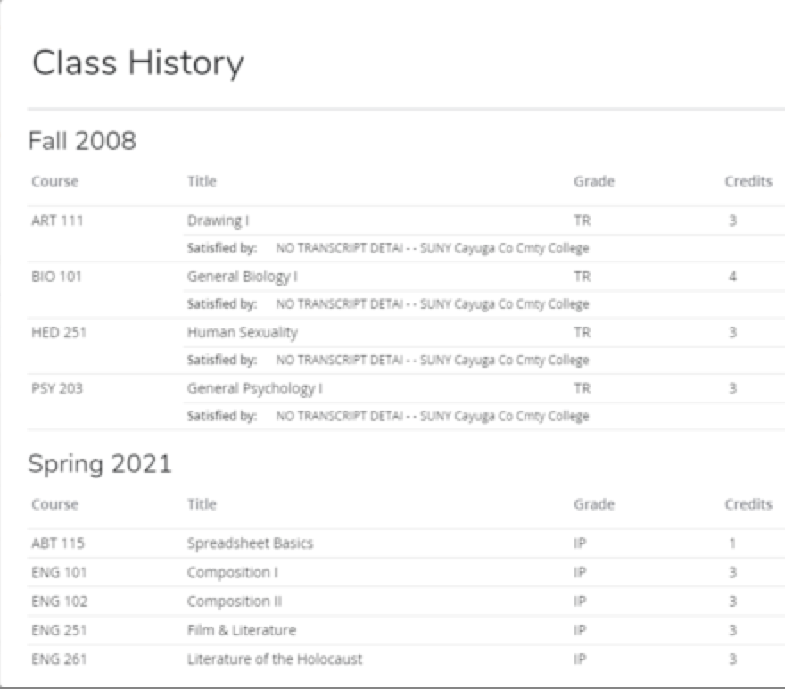
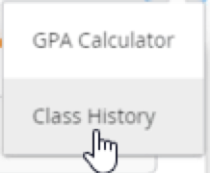
Class History
Class History lists all courses taken at NCC (completed and In-Progress) including any transferred courses, grouped by the term taken.
Access Class History by clicking the Ellipsis (to the right of the email icon and underneath the username.) From the menu, select Class History.
Select Class History

Slide 14
Thank You for Viewing
This lesson listed and described the Class History option and the GPA Calculators. It demonstrated how to operate each GPA calculator, provided user case examples, and interpreted the feedback.
Complete other lessons for more instructions on using Degree Evaluation.

