Slide 1
How to Register Using Banner
myNCC PORTAL

Slide 2
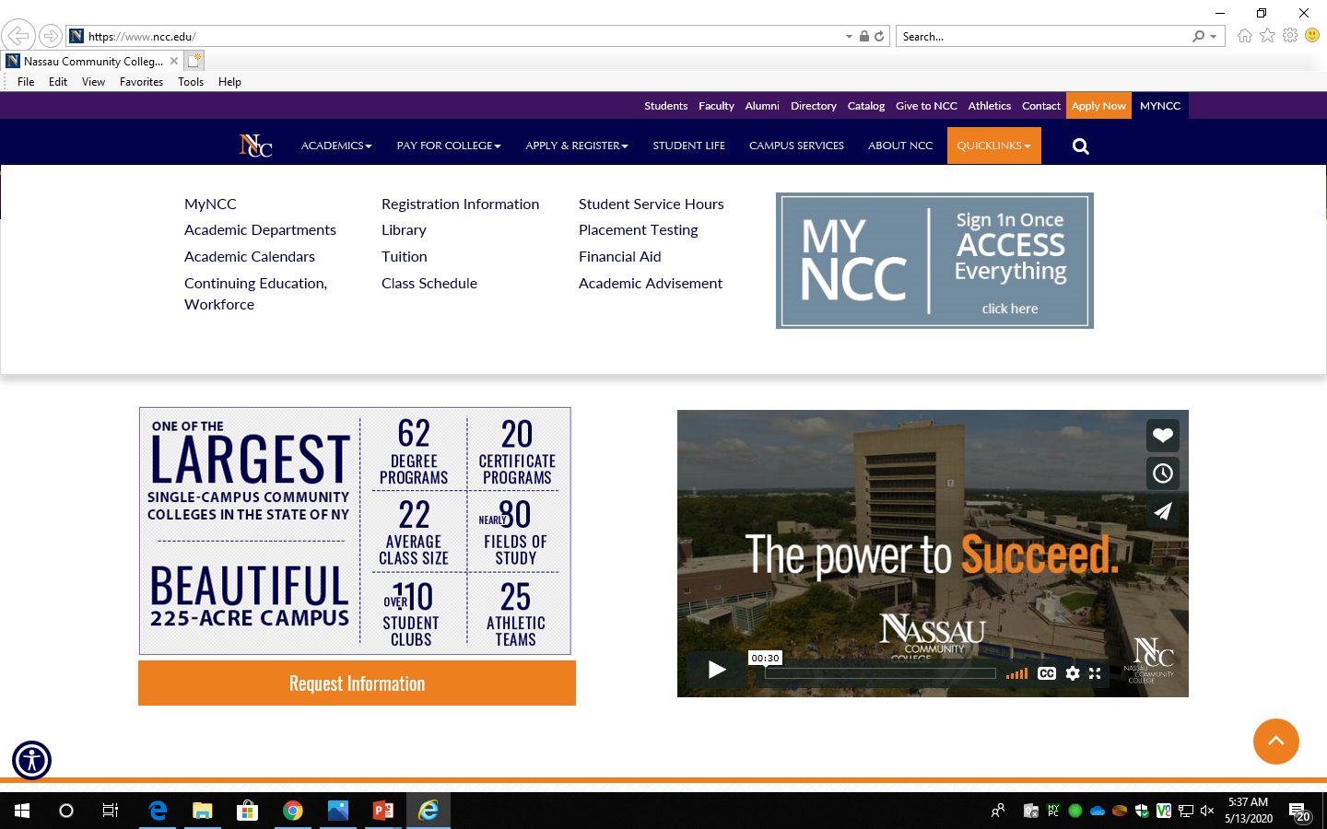
Get Familiar with the College Website
www.ncc.edu
Log into your portal
Clicking on tabs above will display for more information

Slide 3
HOW TO LOG INTO YOUR myNCC PORTAL
Click on myNCC on top right corner to access your PORTAL
Login Username: NCC ID N00_ _ _ _ _ _ Password: 6 digit DOB MMDDYY

Slide 4
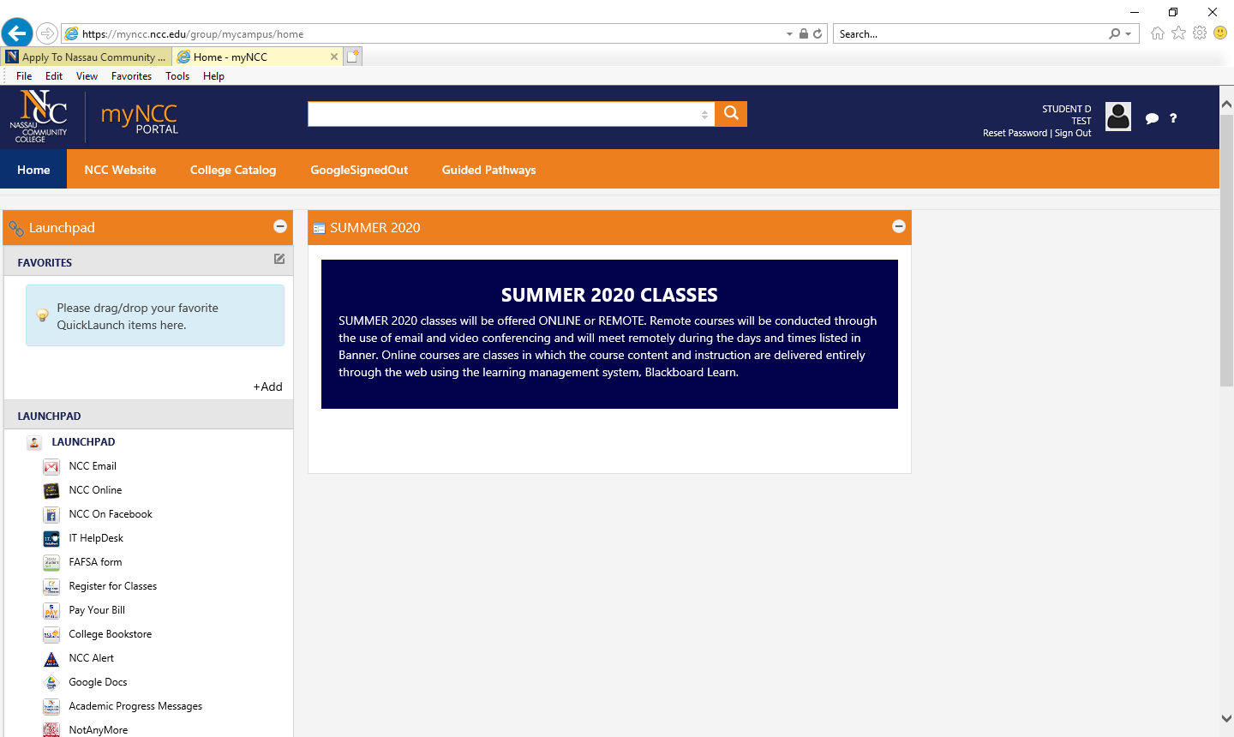
myNCC Portal
In College Catalog, you can view Policies and Procedures, read course descriptions and find additional information to explore your opportunities at NCC
Scroll through your LAUNCHPAD to explore all of the links like your NCC Email account and Register for Classes

Slide 5
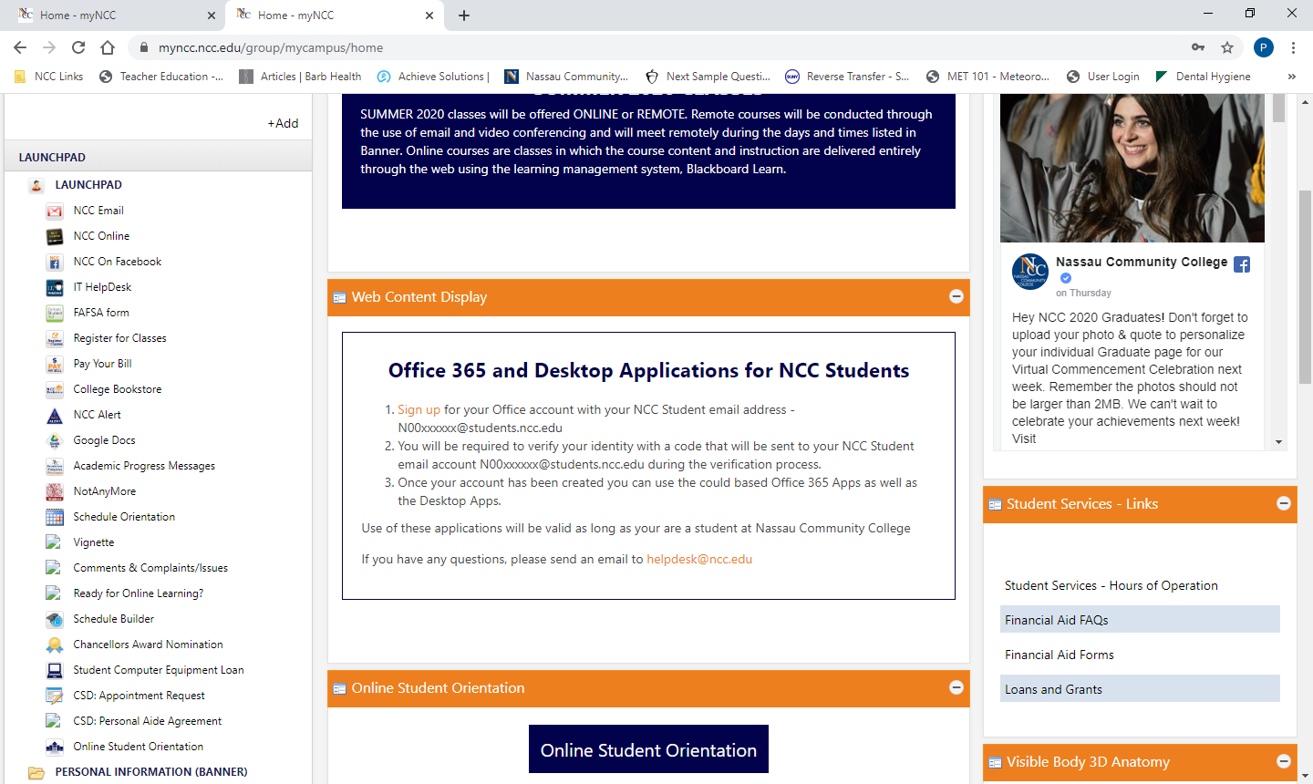
To Register for Classes, find Course Reference Number (CRN), Go to the LAUNCHPAD, select Register for Classes
From the LAUNCHPAD, select Register for Classes

Slide 6
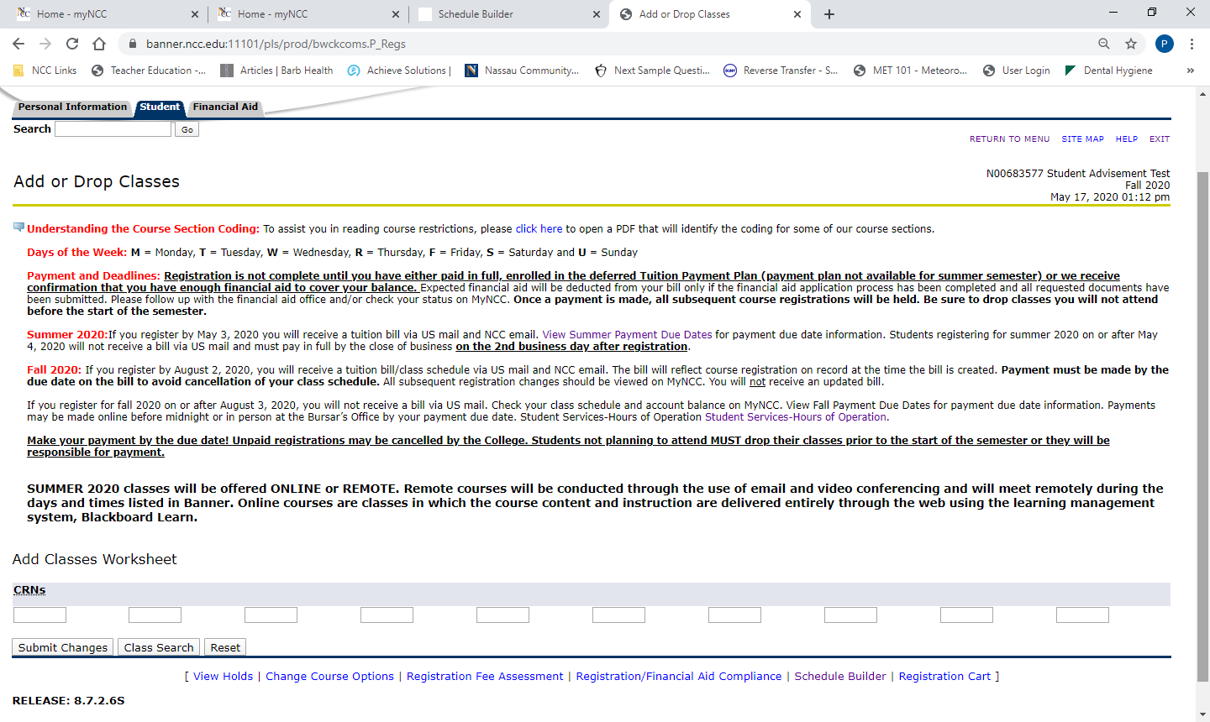
Register for Classes
Select Registrarion Term and Submit
+
On the next Add or Drop Classes page, select Class Search or add CRN’s to boxes below and click submit to register

Slide 7
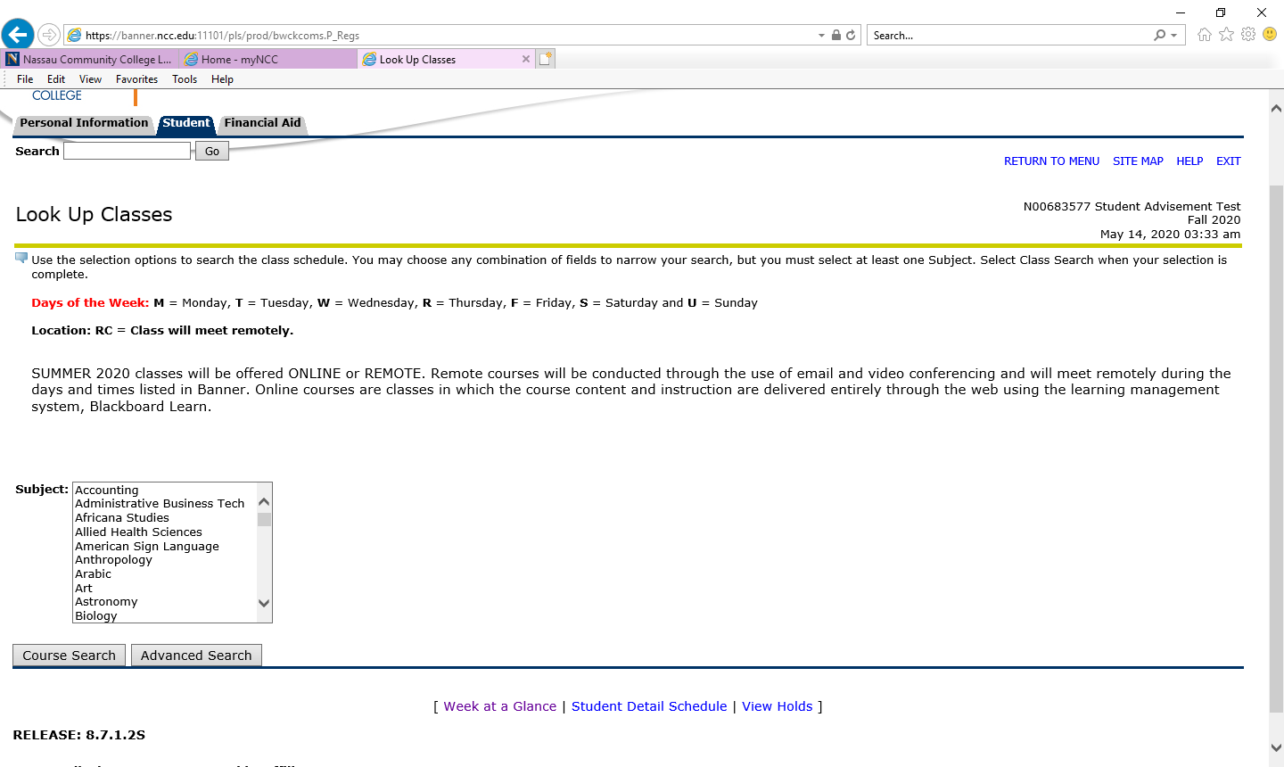
Selecting Classes Using Course Search
You can Look Up Classes by selecting Course Search or Advanced Search
Highlight Subject and Select Course
Search

Slide 8
Selecting Classes Using Course Search Continued
Course Search will allow you to Look Up Classes
Look Up Classes
All classes for highlighted subject will display
Click on view sections for a course in that specific subject area
Highlight the Subject and click on Course Search

Slide 9
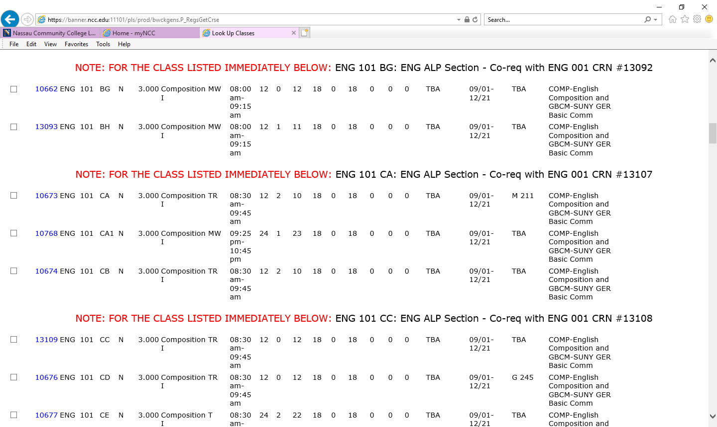
Selecting Classes Using Course Search Continued
1. NOTE indicates course is reserved for a specific group of students
2. Sections are the letters after the course number. The NOTE refers only to the matching section
3. Course Sections that do not have a NOTE above them are options for all students

Slide 10
Selecting Classes Using Advanced Course Search
You can Look Up Classes by selecting Course Search or Advanced Search
Select Advanced
Search

Slide 11
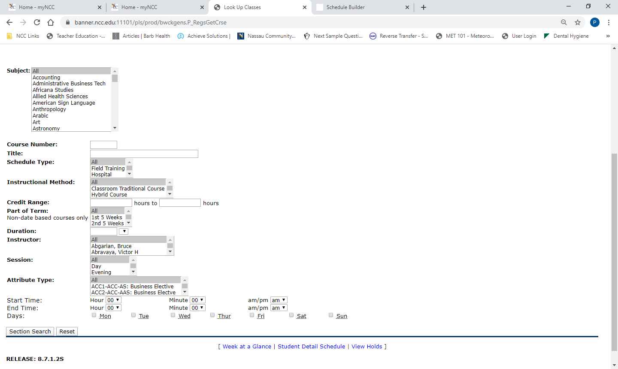
Advanced Search
The most commonly used from the following options are highlighted:
Subject
Course Number
Title
Schedule Type
Instructional Method
Credit Range
Part of Term
Duration
Instructor
Session
Attribute Type
Start Time
End Time
Days
You can select the Subject by scrolling from the launch button
You can insert the Course Number
You can highlight your preferred session: Day, Eve, Online, Remote or Weekend
You can select the “Attribute Type” to see a list of classes with that attribute

Slide 12
Advanced Search by Subject, Session and Attribute Type
Select the Subject
Check box of section you want
Select Session and Attribute Type
Click on Section Search
Register or Add to Worksheet

Slide 13
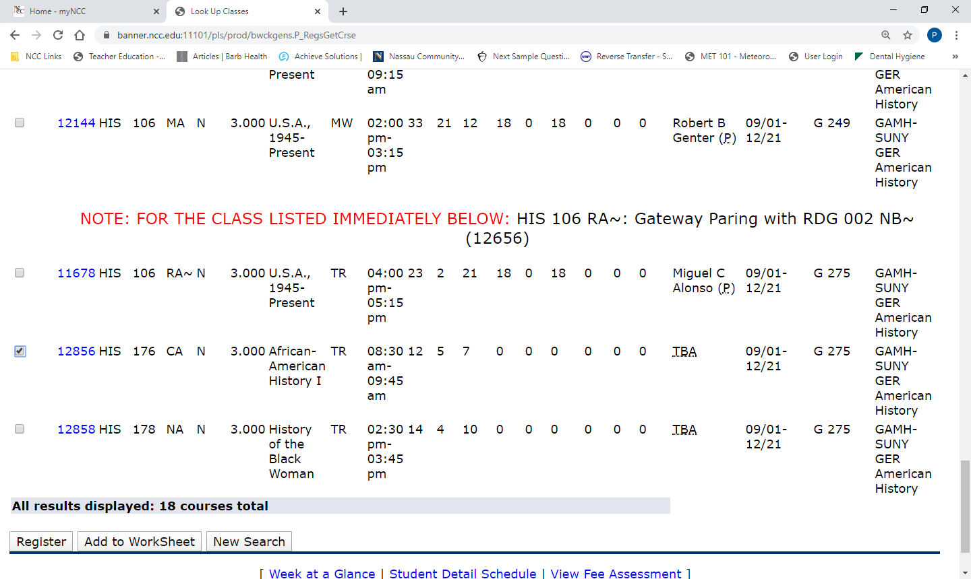
Select Course from Advanced Search Results
Select desired box
Write the day and time of the class you select before you Register
Click Register

Slide 14
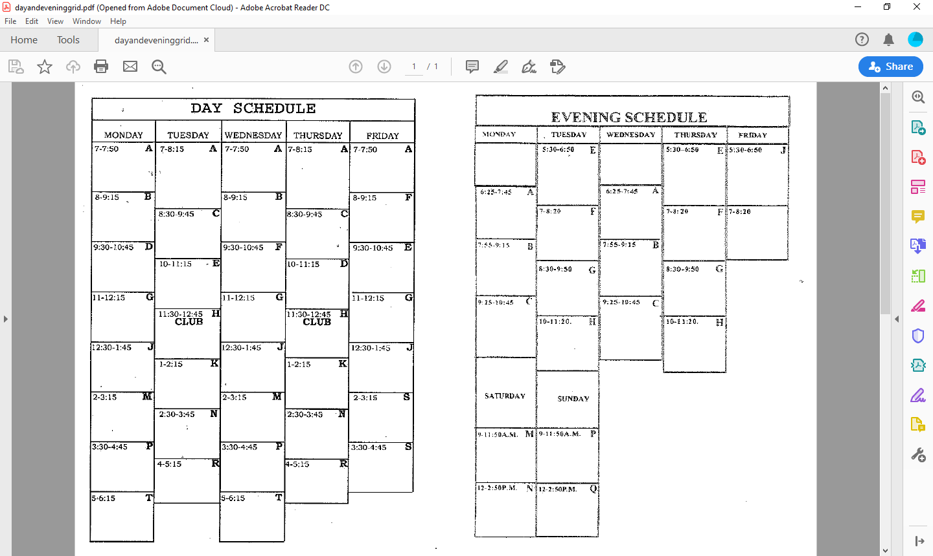
Writing the day and time of the class you selected will avoid creating a time conflict with your next selection
HIS
HIS
Schedule Grids are in Helpful Tools on the Advisement webpage
https://www.ncc.edu/advisement/

Slide 15
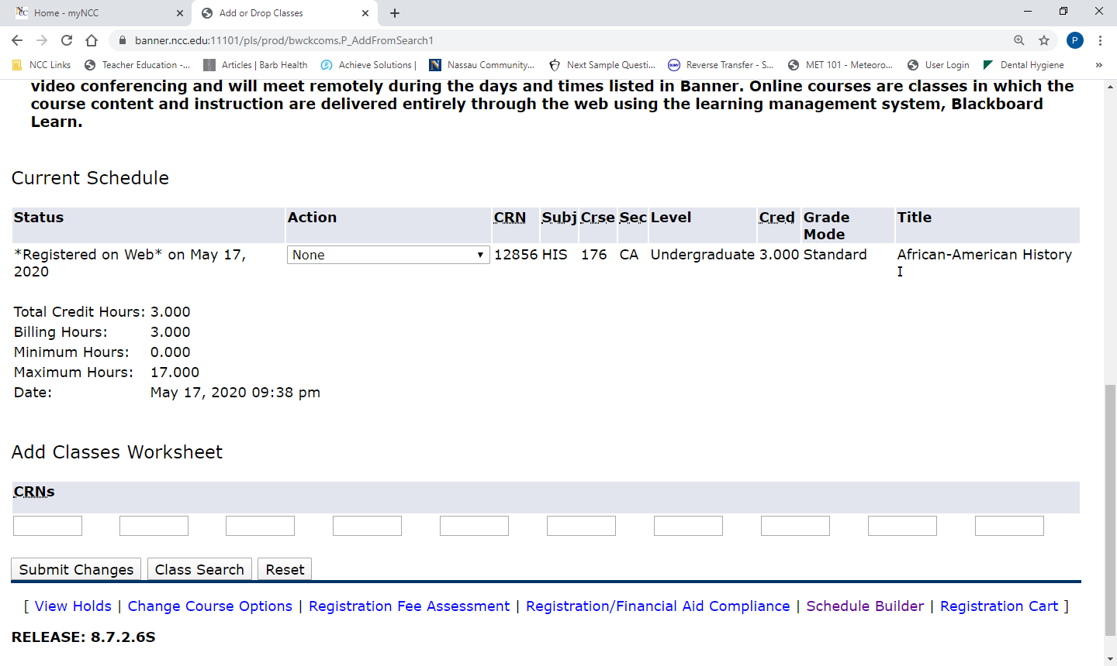
Confirmation of Course Registration on Web
Registered on Web indicates course was added
Click on Class Search to continue to add courses

Slide 16
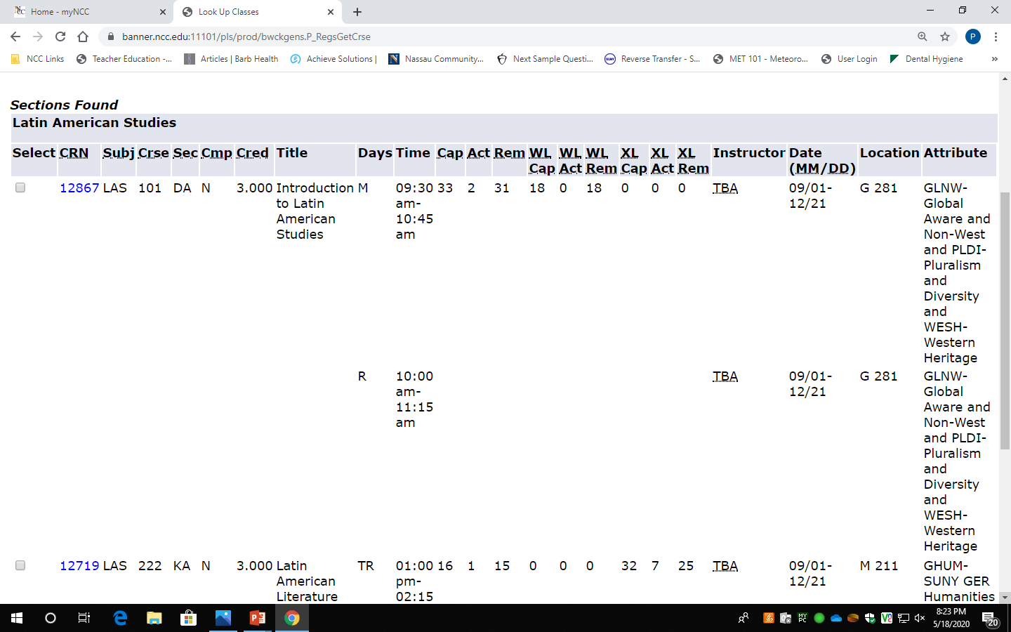
During course selection, note the following information:
Date range
for term
Waitlist
Information on:
Capacity
Actual
Remaining
The check off box indicates the class is open if no one is on the waitlist
Click on CRN hyperlink to read course description in “View Catalog Entry”
All attributes
for course
Location for class meeting

Slide 17
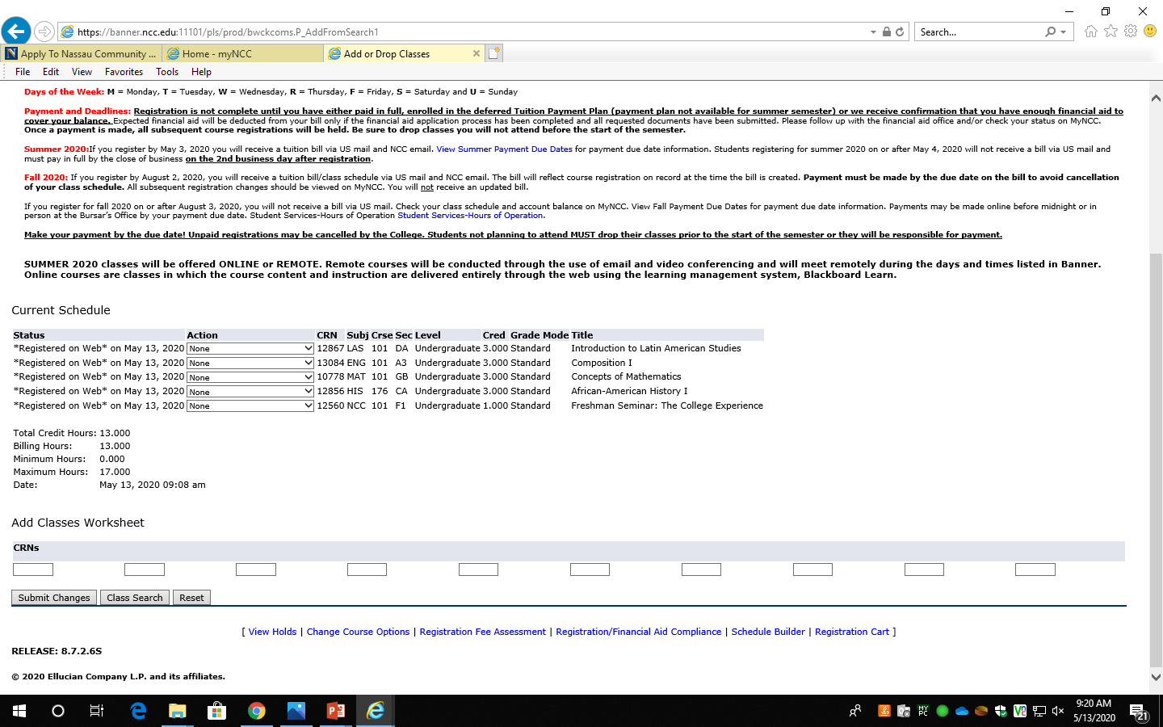
You are now registered for classes. Read information above “Current Schedule” which includes letter codes for each Day of the Week and Payment and Deadline Information
Current list of classes
Total Credit Hours

Slide 18
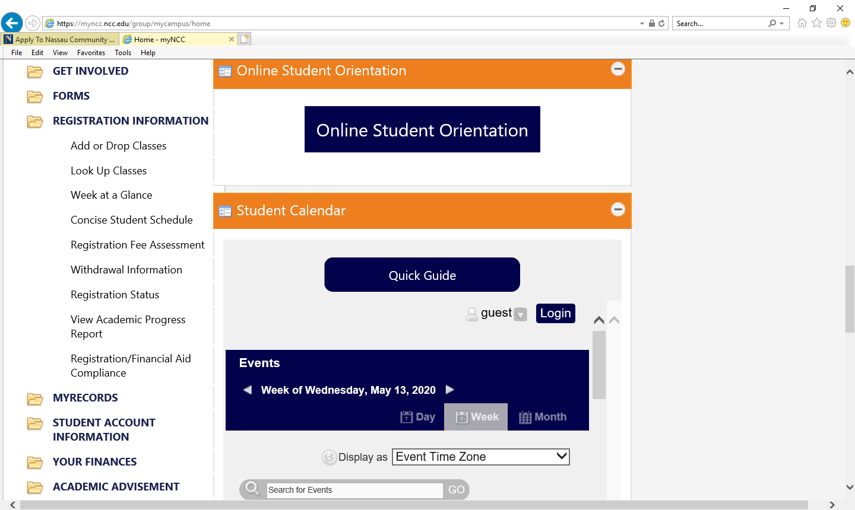
How to View your Schedule on your myNCC Portal
To view your schedule, click on REGISTRATION INFORMATION and select Week at a Glance or Concise Student Schedule

Slide 19
Week at a Glance Schedule
Concise Student Schedule
You can change the week by clicking on Previous Week or Next Week
You can view your schedule for the full term
View Course Information: CRN, Title, Credits, Start and End Date, Days,
Location and Instructor
To view your entire schedule, make sure you select a full week of school

Slide 20
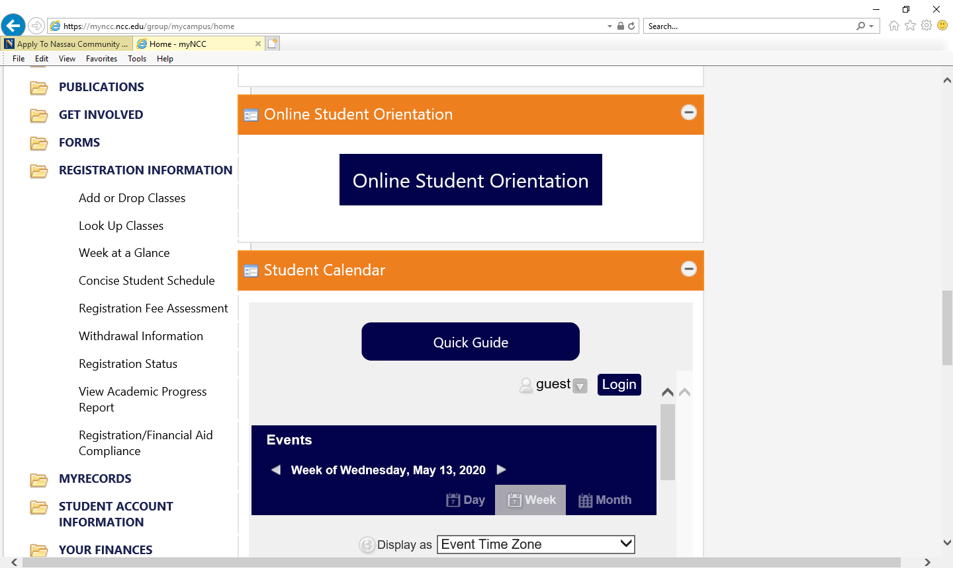
How to Make Changes to your Schedule
On your portal LAUNCHPAD, select the REGISTRATION INFORMATION folder and click on Add or Drop Classes
Click Online Student Orientation, which is required for all New Students
Click on action circle to view Student Calendar for the term

Slide 21
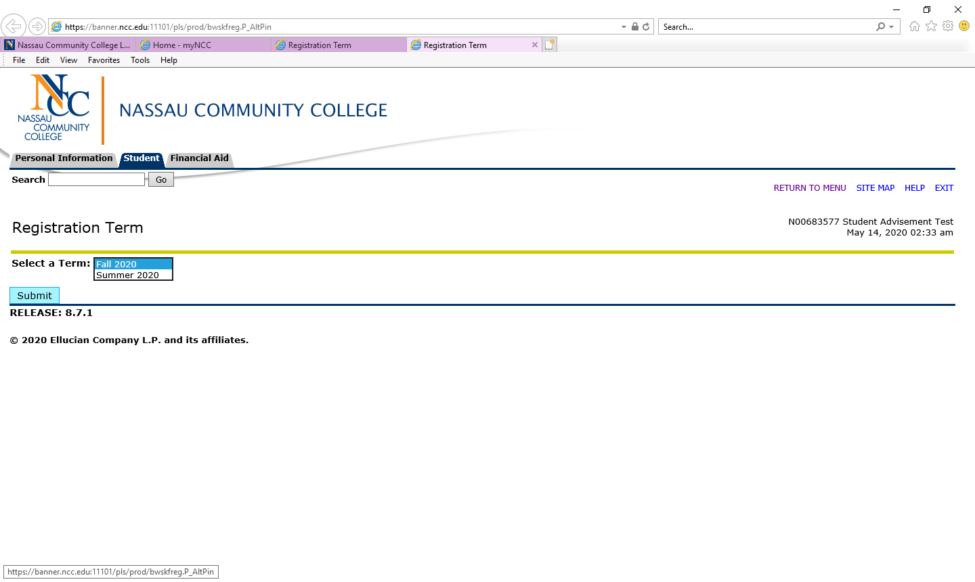
How to Make Changes to your Schedule Continued
Select the Registration Term by clicking on the action arrow
Click on Submit

Slide 22
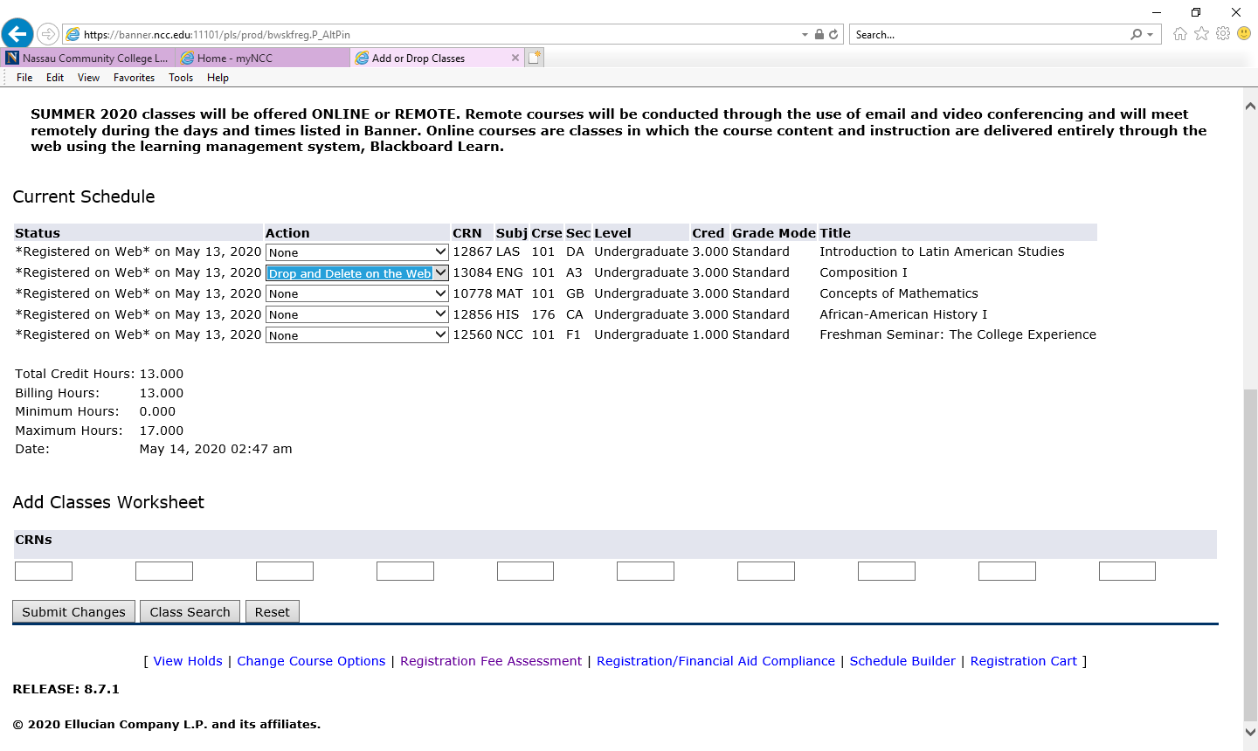
Add or Drop Classes
Select the Action launch button for the class(es) you are dropping and highlight Drop and Delete on the Web.
Make sure you select the correct class(es) to avoid losing the wrong class(es)
Add CRN(s) for the new class(es) to the boxes below to add and drop class(es) simultaneously. If dropping only, click submit changes below
Click Submit Changes to finalize

Slide 23
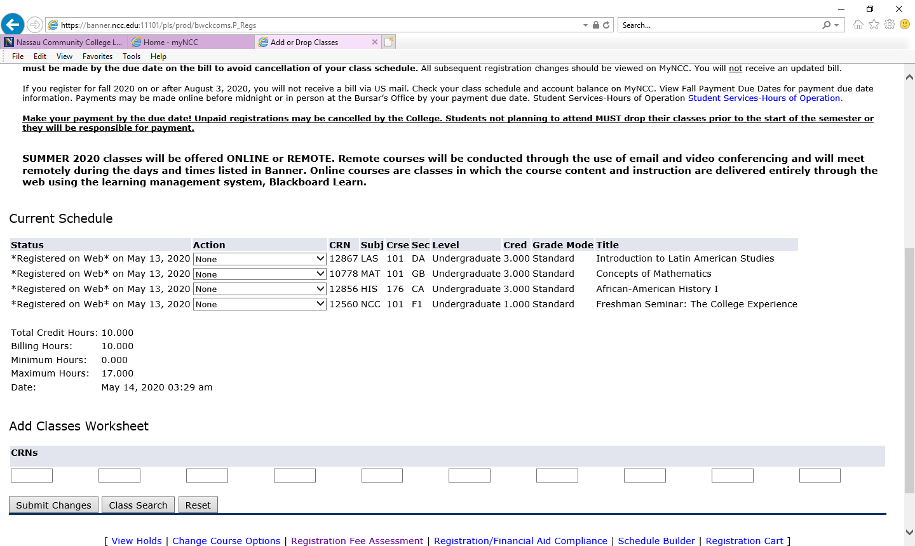
Add or Drop Classes Continued
The class dropped is no longer listed in your Current Schedule
Total Credits Hours are adjusted

